Slide 1
Meteorology-1
Class - 3rd Sem Date - 03/09/2020
Paper - CC5T Unit - 2-2 (Partial)
By - Sandip Tripathy,
Department of Geography, Kharagpur College
Topic - Air Mass : Typology and Origin

Slide 2
Air Mass
Volume of Air
Have a same properties of Water Vapour, Lapse Rate and Temperature
A parcel of Air - Have Same Characteristics Horizontally
Areal extension could be hundred to million of miles
Adopts surface characteristics into it

Slide 3
Properties Conditions
The Age of Air Mass
Properties of Source and Area and Its directions
Gradually Changes adopted with distance increasing from source with time

Slide 4
Basic Principle regarding Air Mass
Vertical Distribution of Temperature and Moisture content are two which controls weather of a surrounding Area
When the Temperature of Air Mass is Lesser than the Underlying Surface is called Cold Air Mass and when is higher than Underlying Surface is generally known as Warm Air Mass
The Boundary of Two Air Mass is called Front

Slide 5
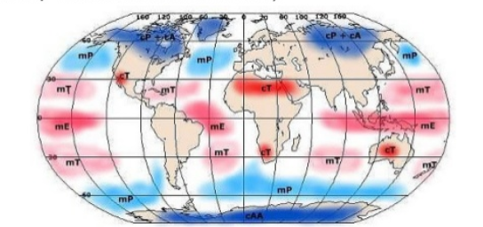
Origin of Air Mass
Source Region-
Forms in High or Low Latitude ; No Mid Latitude
Forms in Extreme High or Low Pressure Zone
Extensive Area with specific Temp and Humidity
There are some Source Regions of forming an Air Mass
Polar Oceanic Areas
Polar and Arctic Continental Areas
Tropical Oceanic Areas
Tropical Continental Areas
Equatorial Regions
Monsoon Region

Slide 6
Typology:
Geographical Classification by Trewartha
Polar Air Mass (P)
Tropical Air Mass (T)
Continental Air Mass (c)
Oceanic Air Mass (m)
Continental Polar Air Mass (cP)
Maritime Polar Air Mass (mP)
Continental Tropical Air Mass (cT)
Maritime Tropical Air Mass (mT)
Continental Air Mass converted into Maritime Air Mass when it crosses over Ocean
Maritime Air Mass Converted into Continental Air Mass when it crosses over continents

Slide 7
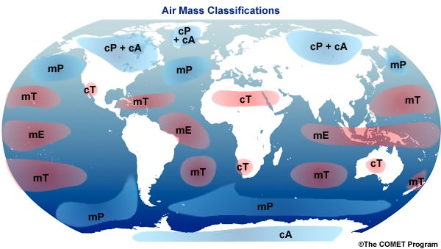

Slide 8
General Type of Air Mass
Arctic Continental -cA
Polar Continental -cP
Polar Maritime -mP
Tropical Continental - cT
Tropical Maritime - mT

Slide 9
Continental Arctic Air Mass - cA
Cold and Extremely Dry Air
The boundary between cA and cP is very low
It can proceed to southern part

Slide 10
Continental Polar Air Mass -cP
Generally formed on Large Landmasses like Canada and Siberia
Cold and Extremely Dry and Less of Moisture
Stability is Very High
On Summer height is more than winter
Modifications:
Makes the underlying area cold and dry
Progression to Lower Altitude, makes it warm
Carrying Capacity of Moisture increased

Slide 11
Maritime Polar Air Mass - mP
Higher latitude waterfronts
Cold and Moist
cP moves as mP in Continents
Otherwise, water front adds moisture to cP
mP air circulates in the eye of a cyclone and
cP makes a passage to cyclone

Slide 12
Continental Tropical Air Mass - cT
Hot and Very Dry
Mainly lower latitude continents
Unstable
Thunderstorm and lightning happens
Local Wind

Slide 13
Maritime Tropical Air Mass -mT
Warm and Humid
From equatorial waterfront
Extremely Unstable
Advection of this makes monsoon locally
Dry and warm wind causes continental summer

Slide 14
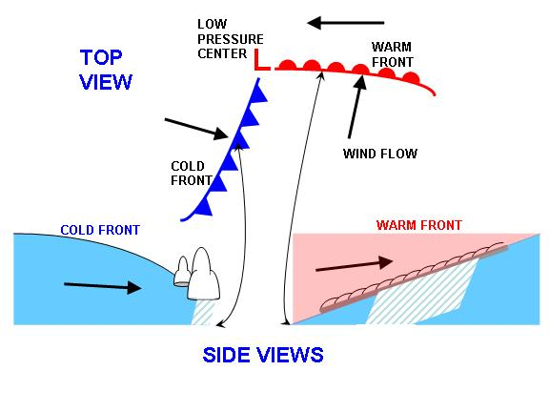
Front
Warm Front and Cold Front
Stationary Front
Occluded Front

Slide 15
Modifications of Air Mass
Initial characteristics of Air Mass including of Temperature and Humidity
Underlying Conditions are important parameters that affects
Path followed through source region to terminal region
Time needed for movement

Slide 16
Type:
Based on Thermodynamic and Mechanical Modifications
Next Day
This topic will continue tomorrow

