Slide 1
COMPILER DESIGN BCA 5th Semester 2020 Topic: Introduction to Compiler
Sakhi Bandyopadhyay
Department of Computer Science and BCA
Kharagpur College

Slide 2
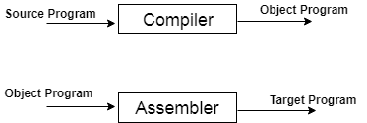
Introduction to Compiler
A compiler is a translator that converts the high-level language into the machine language.
Fig: Execution process of source program in Compiler

Slide 3
Compiler Phases

Slide 4
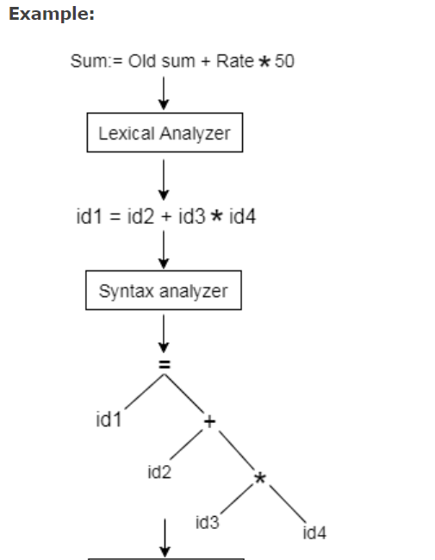
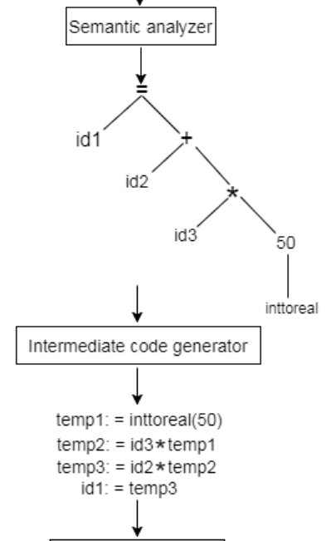
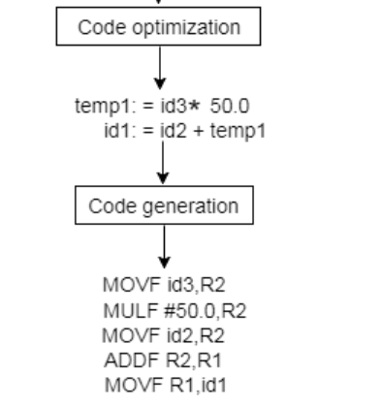

Slide 5
Finite state machine
Finite state machine is used to recognize patterns.
A finite automata consists of following:
Q: finite set of states ∑: finite set of input symbol q0: initial state F: final state δ: Transition function
Transition function can be define as
δ: Q x ∑ →Q

Slide 6
FA is characterized into two ways:
DFA (finite automata)
NDFA (non deterministic finite automata)
DFA
DFA stands for Deterministic Finite Automata.
In DFA, the input character goes to one state only.

Slide 7
DFA
DFA has five tuples {Q, ∑, q0, F, δ}
Q: set of all states ∑: finite set of input symbol where δ: Q x ∑ →Q q0: initial state F: final state δ: Transition function
Example
See an example of deterministic finite automata:
Q = {q0, q1, q2}
∑ = {0, 1}
q0 = {q0}
F = {q3}

Slide 8
NDFA
NDFA refer to the Non Deterministic Finite Automata. It is used to transit the any number of states for a particular input. NDFA accepts the NULL move that means it can change state without reading the symbols.
Transition function of NDFA can be defined as:
δ: Q x ∑ →2^{Q}
Example
Q = {q0, q1, q2}
∑ = {0, 1}
q0 = {q0}
F = {q3}

