Slide 1
The Photoelectric effect
Dr. Samir Kumar Giri
Department of Physics
Kharagpur College
Dr. Samir Kumar Giri, Dept. Of Physics, Kharagpur College

Slide 2
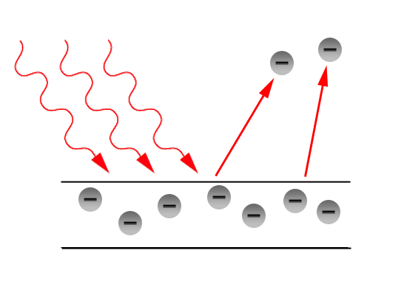
The Photoelectric effect
Introduction:
First observed by Heinrich Hertz in 1887 ‐
light shining on a metal plate causes electrons
to be knocked loose (ejected) from the metal plate.
Several aspects of the phenomena could
not be explained in terms of an electromagnetic
Wave.
Increasing the brightness of the light did not eject faster electrons ‐
think of light as a wave ‐ brighter light (bigger amplitude wave)
should eject more energetic (faster) electrons.
Energy and number of ejected electrons depends on light(frequency)
‐ for some metals, red light would not eject any electrons at all even
it very high ‐ blue lights ejects very fast electrons even if very dim.
The electrons were emitted immediately ‐ no time lag ‐ if light is dim,
expect a delay while the waves wiggle the electrons and break them
loose.
Dr. Samir Kumar Giri, Dept. Of Physics, Kharagpur College

Slide 3
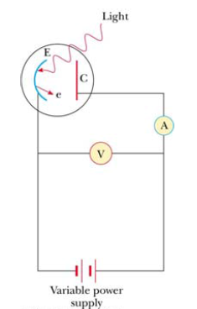
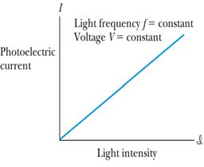
Typical Experimental Setup
When light strikes E, photoelectrons are emitted
Electrons collected at C and passing through the ammeter are a current in the circuit
C is maintained at a positive potential by the power supply
Observations of Photo‐electric effect
The kinetic energy of the photoelectrons is independent of the light intensity.
The kinetic energy of the photoelectrons, for a given emitting material, depends only on the frequency of the light.
When photoelectrons are produced, their number (not their kinetic energy) is proportional to the intensity of light.
Also, the photoelectrons are emitted almost instantly following illumination of the photocathode, independent of the intensity of the light.
Dr. Samir Kumar Giri, Dept. Of Physics, Kharagpur College

Slide 4
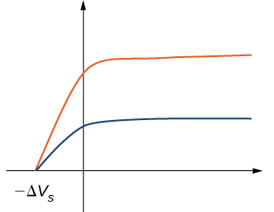
Photoelectric Current/Voltage
Photocurrent
High Intensity
The current increases with intensity, but reaches a
saturation level for large ΔV’s
No current flows for voltages less than or
equal to –ΔV_{s}, the stopping potential
The stopping potential is independent of the
radiation intensity
Low Intensity
Potential Difference
Cutoff Wavelength
The cutoff wavelength is related to the work function λ_{c}=hc/w
Wavelengths greater than λ_{c} incident on a material with a work function w don’t result in the emission of photoelectrons
A specific value of V can be found at which the ammeter reading just drops to zero. This is
called the stopping potential (V_{stop}).
• When the potential is at V_{stop} the most energetic electrons were turned back just before
hitting the collector.
• This indicates that the maximum kinetic energy of the photoelectrons, K_{max}= e V_{stop}
where e is the elementary charge. interestingly, it was found that Kmax does not depend
upon the intensity of the incident light.
• It is difficult to explain this observation with classical
Dr. Samir Kumar Giri, Dept. Of Physics, Kharagpur College

Slide 5
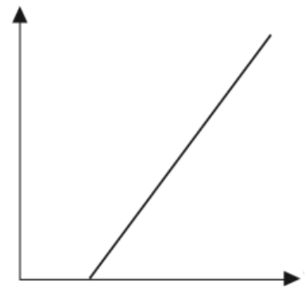
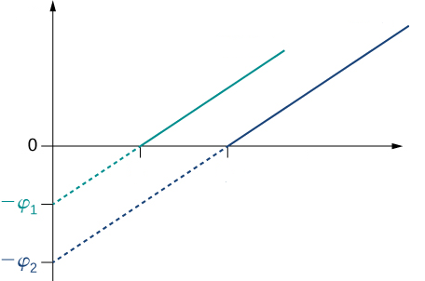
When the maximum kinetic energy is plotted as a
function of frequency a graph like that on the right
results.
Note that there is no photoelectric effect if the
light is below a certain cutoff frequency, ν₀. This
occurs no matter how bright the incident light is.
E_{max}
ν₀
ν
Photoelectric effect graphs for three different metals:
The work function of each metal can
be determined by taking the negative
y‐intercept of each line.
The cutoff frequency of each metal
can be determined by taking the x
intercept of each line
Note that two lines have the
same slope. This slope is Planck’s constant
E_{max}
Metal 2
Metal 1
frequency
Dr. Samir Kumar Giri, Dept. Of Physics, Kharagpur College

Slide 6
Physics/Wave Theory Not Explained the Features
• No electrons are emitted if the incident light frequency is below some cutoff frequency that is characteristic of the material being illuminated
• The maximum kinetic energy of the photoelectrons is independent of the light intensity
• The maximum kinetic energy of the photoelectrons increases with increasing light frequency
• Electrons are emitted from the surface almost instantaneously, even at low intensities
Explanation of Classical “Problems”
• The effect is not observed below a certain cutoff frequency since the photon energy must be greater than or equal to the work function – Without this, electrons are not emitted, regardless of the intensity of the light
• The maximum KE depends only on the frequency and the work function, not on the intensity
• The maximum KE increases with increasing frequency
• The effect is instantaneous since there is a one-to-one interaction between the photon and the electron
Dr. Samir Kumar Giri, Dept. Of Physics, Kharagpur College

Slide 7
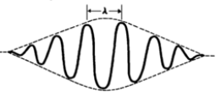
Quantum Theory of The Atom
In 1901, Max Planck suggested light was made up of ‘packets’ of energy:
E=nhν
E = Energy of Radiation, v = Frequency
n (Quantum Number) = 1,2,3…….n, h = Planck’s Constant
Atoms, therefore, emit only certain quantities of energy and the energy of an atom is described as being “quantized”
Thus, an atom changes its energy state by emitting (or absorbing) one or more quanta
Photons
Quantum theory describes light as a particle called
a photon with wave
According to quantum theory, a photon has
an energy given by E = hν = hc/λ
The energy of the light is proportional to
the frequency, and inversely proportional to the
wavelength! The higher the frequency (lower wavelength) the higher the energy of the photon! 10 photons have an energy equal to ten times a single photon.
The quantum theory describes experiments to astonishing precision,
whereas the classical wave description cannot
Representation of Photon
Dr. Samir Kumar Giri, Dept. Of Physics, Kharagpur College

Slide 8
Einstein's equation for photoelectric effect

Slide 9
Einstein's equation for photoelectric effect
Kinetic energy of ejected electron
Einstein proposed an explanation for the photoelectric effect which would play a large role in his receiving the Nobel Prize
in Physics in 1921.
• Rather than the classical model of light as a continuous wave, Einstein viewed light as discrete packets of energy called photons. hf , 2hf ,3hf…… nhf
• Taking advantage of Planck’s discovery of the quantization of energy, Einstein determined that each photon had
energy E=hf. The energy transferred to an electron
• by light was no longer considered to depend on intensity, but on
frequency
Energy needed to remove electron from metal
½mv²
hν
w
w
Energy supplied
by photon
hν
Dr. Samir Kumar Giri, Dept. Of Physics, Kharagpur College

Slide 10
Einstein’s Explanation
The electrons are bound to the material by attractive forces. Hence, work must be done to free an electron:
“Work Function” depends on the materials
hν= KE_{max} + w
Minimum work required to free electron
Incident Photon energy
Maximum Kinetic energy of dislodged electron
Energy from the light beam is transferred to the electrons in the solid by photons which have
an energy related to the frequency of the beam.
The photon’s energy would be E = hν
Each photon can give all its energy to an electron in the metal
The electron is considered to be in a well of height frequency which is called the work
function of the metal
Because of energy conservation the maximum kinetic energy of the liberated
photoelectron is
KE_{max} = hν - w
Dr. Samir Kumar Giri, Dept. Of Physics, Kharagpur College

Slide 11
Work Function
Work function is the minimum amount of energy that has to be given to an electron to release it from the surface of the material and varies depending on the material
Threshold Frequency
hν₀= w
hc/λ₀= w, c = speed of light, λ_{o} = wavelength
Dr. Samir Kumar Giri, Dept. Of Physics, Kharagpur College

