Slide 1

Renewable Energy and Energy Harvesting
SEM4, SEC2T
Jyotirmoy Pramanik
Dept of Physics, Kharagpur College Kharagpur – 721305

Slide 4
Contents
Introduction to Renewable Energy Sources
All India Generating Installed capacity
Relevancy of RES
Solar Cell
Solar Water Heating System
Hydro Energy
Wind Energy
Biomass Energy
Geothermal Energy
Current Status of Grid Connected Renewable Energy
Conclusions

Slide 5
Renewable Energy Sources
  Renewable energy is energy produced from sources that do not deplete or can be replenished within a human’s life time. The most common examples include wind, solar, geothermal, biomass, and hydropower.
  Renewable Energy Sources
    Radiant solar energy
      Solar heating (passive and active), solar power plants, photovoltaic cells
    Biomass energy
      Direct: combustion of biomass
      Indirect: chemical conversion to biofuel
    Wind energy
    Hydro energy
    Geothermal energy

Slide 6
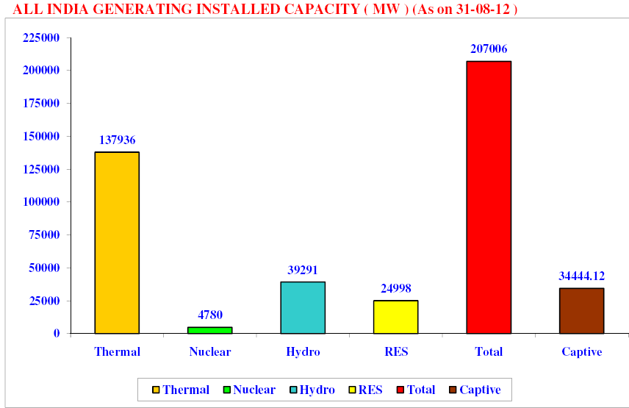

Slide 7
Relevancy……..
What are the problems with conventional sources?
Fossil fuels:
Pollution → Polluted air, water and land causes many chronic and asthmatic diseases, global warming, draught, change in climate etc.
Power → Plants and animals had been decomposed to fossil fuels in a long time chemical process under an elevated pressure and temperature. This is completely natural process and men can not reproduce this environment. Therefore, the Earth will eventually run out of fossil fuels within the next 50 years as estimated. Then what is after 50-100 years…….?
Nuclear power:
Radioactivity
→ From the nuclear reactors, some penetrating radiation or particles emission occur which are very harmful for living elements of the Earth,
→ Damping cost of the radioactive waste products and remaining parts of the reactors is very high.
Though seawater uranium is effectively inexhaustible, it not considered as
"renewable energy sources" for provision of development support.

Slide 8
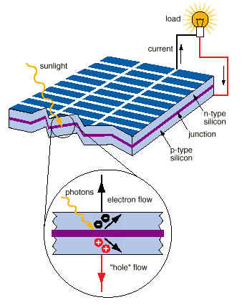
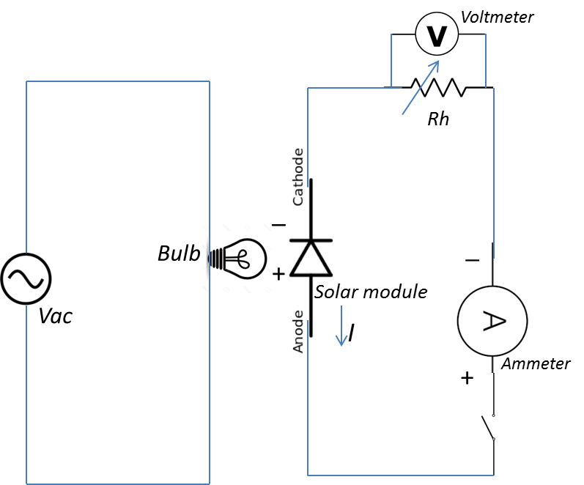
Solar cell
Solar cell a semiconductor device which can convert light energy to electric energy.
Principles:-
When Photons are incident on the solar cell it reaches to the depletion region and creates the electron-hole pairs. These electrons are moved towards the n-type of cell and holes are moved towards the p-type of the cell. As a result charge imbalance occurs. Now if we connect the n-type side to the p-type side of solar cell by means of an external ckt , current flows through the ckt because this reduces the light induced charge imbalanced in the cell. This effect is called photo-voltaic effect.

Slide 9
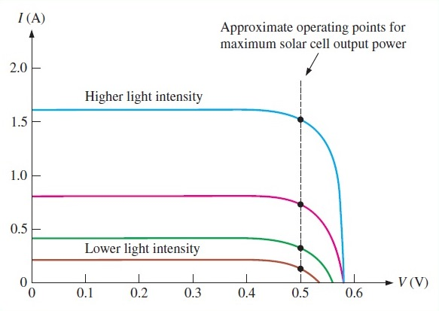
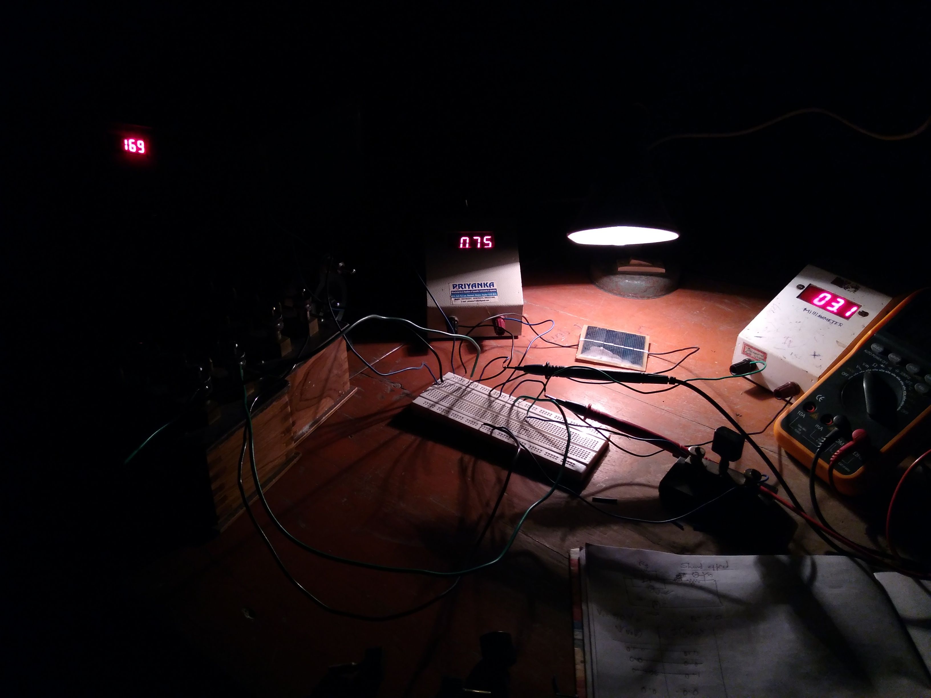
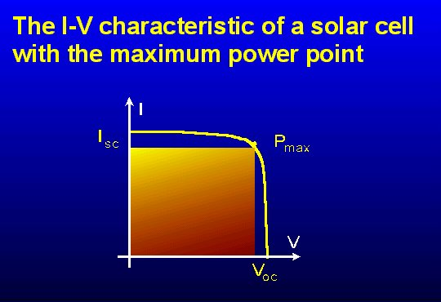
Solar cell……
A Picture of experimental setup
V_{m} . I_{m} (P_{max})
Fill Factor(FF) = ------------------
V_{oc} . I_{sc}
(lies between 0.7 to o.8)
P_{max}
Conversion Efficiency,η= ------- P_{in}

Slide 10
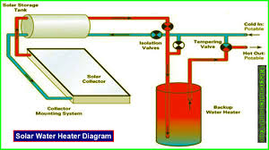
Solar Water Heating System
The system is generally installed on the roof or open ground, with the collector facing the sun and connected to a continuous water supply.
The collector usually comprises copper tubes welded to copper sheets (both coated with a highly absorbing black coating) with a toughened glass sheet on top and insulating material at the back. The entire assembly is placed in a flat box.
Water flows through the tubes, absorbs solar heat and becomes hot.
The heated water is stored in a insulated tank for further use.

Slide 11
Hydro Energy
Advantages:
It does not cause any pollution
It is a cheap and renewable source of electricity which will never get exhausted.
Disadvantages:
Human population displacement.
The soil in the down stream becomes poor in quality.

Slide 12
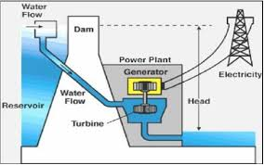
Hydro Energy
In hydroelectric power station, the flowing water is stopped in high altitude rivers by constructing dams and is stored in huge reservoir behind the dam. The water stored possessed very large amount of potential energy. Then the water is allowed to fall through pipes on the blades of big water called turbines. These turbines are connected to electric generators.
Name of few Hydroelectric power plant in India are as, Tehri Dam, Uttrakhand, 2400 MW; Sardar Sarovar Dam, Gujarat, 1450 MW; Bhakra Nangal Dam, Himachal Pradesh, 1325 MW; Purulia Pass, West Bengal, 900 MW; Nagarjuna Sagar Dam, Andhra Pradesh, 960 MW, Hirakudh Dam, Orissa, 500 MW; etc.

Slide 13
Working Principle of Wind Turbines
Wind turbines work on a simple principle: instead of using electricity to make wind—like a fan—wind turbines use wind to make electricity.
The energy in the wind turns two or three propeller-like blades around a rotor. The rotor is connected to the main shaft, which spins a generator to create electricity.
The wind systems that exist over the earth's surface are a result of variations in air pressure.
Advantages
  High net energy yield
  Renewable and free
  Very clean source of energy
    No pollution (air or water) during operation
  Long operating life
  Low operating/maintenance costs
  Land can be used for other purposes
    Can combine wind and agricultural farms
Disadvantages
  Energy storage issues
    An intermittent source of energy; need backup (eg stored energy) for low-wind days
    Or must be connected to the electrical grid
  Only practical in areas that are windy enough

Slide 14
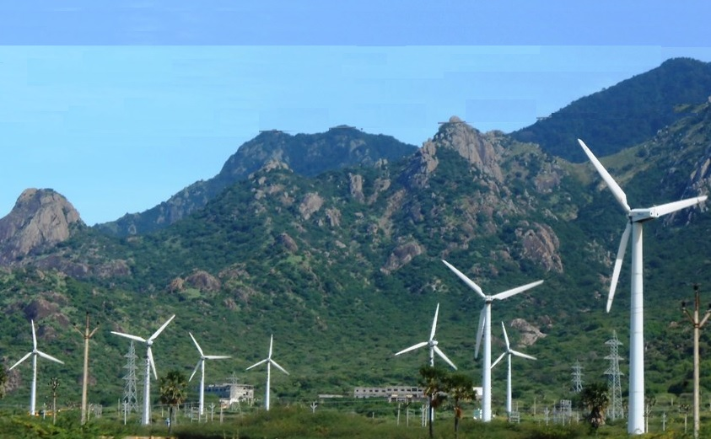
Windmill Park at Kanyakumari District of Tamilnadu

Slide 15
Biomass Energy
What is it?
  Biomass energy is the use of living and recently dead biological material as an energy source
  Ultimately dependent on the capture of solar energy and conversion to a chemical (carbohydrate) fuel
  Theoretically it is a carbon neutral and renewable source of energy
How it works?
  Traditional: forest management, using wood as fuel
  Use of biodegradable waste
    Examples: manure, crop residue, sewage, municipal solid waste
  Production of a liquid or gaseous biofuel
    Biogas due to the breakdown of biomass in the absence of O₂
      Includes capture of landfill methane
    Bioethanol from fermentation, often from corn. Cellulosic bioethanol is usually from a grass (switch grass)
    Biodiesel from rapeseed and other sources

Slide 16
Biogas Production Processes
Biogas is generated when bacteria degrade biological material in the absence of oxygen, in a process known as anaerobic digestion. Since biogas is a mixture of methane and carbon dioxide, it is a renewable fuel produced from waste treatment.
Many microorganisms affect anaerobic digestion, including acetic acid-forming bacteria (acetogens) and methane-forming archaea (methanogens). These organisms promote a number of chemical processes in converting the biomass to biogas.
The four key stages of anaerobic digestion involve hydrolysis, acidogenesis, acetogenesis and methanogenesis. The overall process can be described by the chemical reaction, where organic material such as glucose is biochemically digested into carbon dioxide (CO₂) and methane (CH₄) by the anaerobic microorganisms.
C₆H₁₂O₆ → 3CO₂ + 3CH₄
Advantages
  Versatile
  Renewable
Disadvantages
  Low energy density/yield
    In some cases (eg, corn-derived bioethanol) may yield no net energy

Slide 17
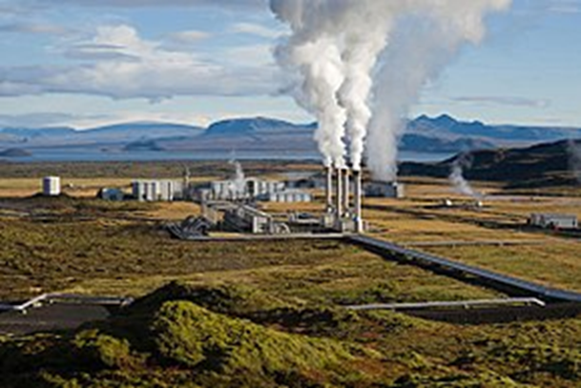
Geothermal Energy
How it works
  Geothermal power plants
    Use earth’s heat to power steam turbines
  Geothermal direct use
    Use hot springs (etc) as heat source
  Geothermal heat pumps
Advantages
  Renewable
  Easy to exploit in some cases
  CO₂ production less than with fossil fuels
  High net energy yield
Disadvantages
  Not available everywhere
  H₂S pollution
  Produces some water pollution (somewhat similar to mining)

Slide 18
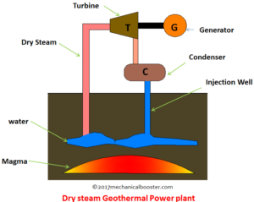
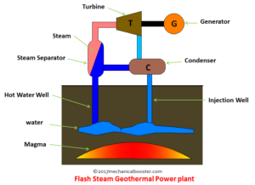
Working Principle of Geothermal Power Plant:
The increase in temperature below the surface of earth is measured using geothermal gradient. Except near the tectonic plate boundaries it is about 25° C per km of depth.
The magma heats the water present inside the earth and increases its temperature greater than 182 degree Celsius. This hot water from the earth is piping to the surface of the earth through hot water wells. The steam from the hot water is separated and made it to strike on the turbine blade and it starts rotating. A Generator is coupled to the turbine also starts rotating and produces electricity.
In South America, Central America, Japan, Malaysia, Indonesia, and Philippine, Electricity generates from Geothermal Thermal energy.

Slide 19
RENEWABLES
CURRENT STATUS OF GRID CONNECTED RENEWABLE ENERGY RESOURCES
The JNNSM aims at adding 20,000 MW solar power capacity by 2022.
The Ministry of New and Renewable Energy (MNRE) is envisaging a capacity addition of about 30,000 MW from renewable during 12th Plan
The total installed capacity from renewable is 22447 MW (December 2011)
A total installed capacity of 15880 MW of wind power
Target of 15000 MW has been proposed for 12th plan.
The cumulative biomass power /bagasse cogeneration based power
capacity has reached 3056 MW.
Global renewable energy annual capacity grew from 64.6 GW in 2010 to 75.6 GW in 2011

Slide 20
Frequency Control: Frequency changes are the direct measurement of demand/supply balances. Drop in frequency means greater demand, vice-versa rises in frequency are indications of reductions of customer loads.
Conventionally frequency control is provided by fine tuning of hydro plants.
The problems due to intermittency come into effect only when the penetration level of intermittent sources goes above acceptable levels (usually 10% to 15% of the total energy production).
Spinning reserves: The spinning reserve is the extra generating capacity that is available by increasing the power output of generators that are already connected to the power grid. Such spinning reserves should be able to tolerate the unpredictable fluctuation in the renewable energy production.
Peak loading: The wind and solar power systems have a very low production cost so these units will be the first to get connected to the grid and will help in reducing the requirement for the peaking power plants during the day time or during high wind speeds.

Slide 21
Piezoelectricity
Certain materials especially the crystalline ones, produce an emf when deformed by an application of pressure along the specific axis. This phenomena is known as piezoelectricity or piezoelectric effect.
For details click in the below link.

Slide 22
Summary
The renewable sources are cost effective, user-friendly, so that they can easily beat the fossil fuels.
By promoting renewable energy sources we can avoid, Air pollution, soil pollution and water pollution.
Country’s Economy will increase.
Due to technological advancement vehicles are made with improved fuel efficiency and also perfect hybrid vehicle are made.
Throughout the year these sources are available without affecting the Environment.

Slide 23
Self Assessment Questions
Solve VU 2019 question.
Write down working principle with necessary diagram of Solar Cell, Solar Water Heating System, Solar Cooker, Wind Turbine, Hydro electric Power generation, Geothermal Energy Harvesting and Biogas Plant.
Name Five Hydroelectric Power Station India with their installed capacity.
Write down the composition of Biogas.
What is Photovoltaic Effect.
Write down different types of Wind-turbine,
Why solar water heating tubes were kept inside glass plates.

Slide 24

Suggestions
For any quarry, mail to
jotir_moy@yahoo.com or contact through mobile.

