Slide 1
Meteorology-3
Class - 3rd Sem Date - 05/09/2020 Paper- CC5 Unit - 2-8 (Partial)
BY - Sandip Tripathy, Department of Geography, Kharagpur College
Topic Covered - Climatic Classification by Köppen

Slide 2
Climatic Classification:
Scheme
Climate is an complex Phenomena
To identify, explain, separate, recognize it need to find out difference between climates over the world.
Several meteorologist divided world climates into several categories.
Koppen is the most popular meteorologist who divided the world climate among others.
Scheme means the Properties/Character, On the basis of that division of world climate takes place. Scheme may be Average Temperature, Precipitation, Diurnal Temperature difference etc.
The base could be Variation in Macro Climate or Micro Climate
Classification Could be Genetic or Descriptive

Slide 3
Köppen
Biography, Background and Scheme
German-Russian Climatologist Koppen first published his classification in 1864.
Later in 1918 and 1936, republished it with much of modification
Later Rudolf Geiger again published his work with plenty of modifications and thus it became popular with Koppen- Geiger Classification.
Scheme of his classification is Relation between distribution of vegetation and climate
Here climate means he used temperature and precipitation
He used the Mean Annual and Mean Monthly Temperature and Precipitation Data
Interestingly He used Capital and Small Letters and assign different Climatic class and subtypes

Slide 4
Major Climatic Groups
According to Koppen
A - Tropical - Average Temperature for the Coldest Month is 18 degrees Celsius or higher
B- Dry Climates - Potential Evaporation exceeds Precipitation
C- Warm Temperate - The Average temperature of the coldest month of the year is higher than -3 degree Celsius but more than 10 degree Celsius
D - Cold Snow Forest Climate - The average temperature of the coldest month is -3 degree Celsius or below
E - Cold Climate - Average temperature of All month is below 10 degree Celsius
H - Highland - Cold Due to Elevation

Slide 5
Minor Division
Of Koppen’s Classification

Slide 6
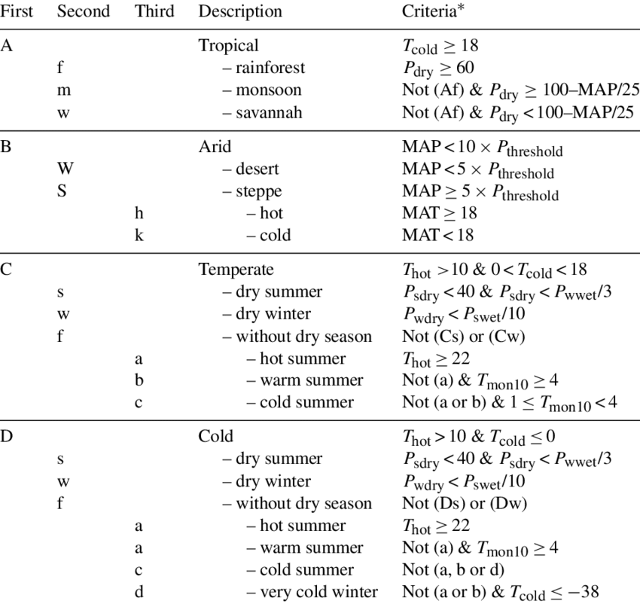

Slide 8
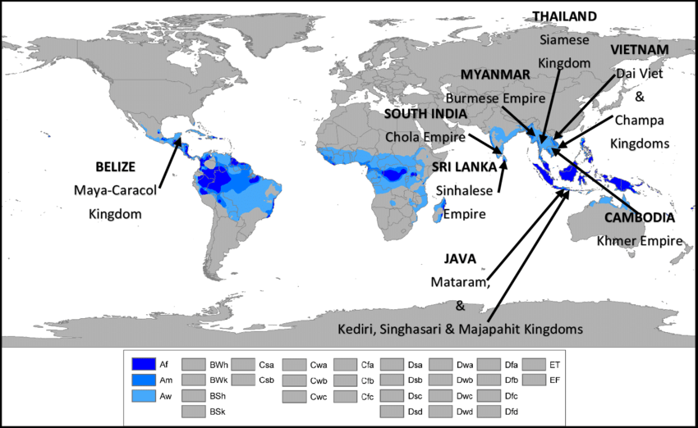
Tropical Humid Climate
Koppen’s Classification
Af - Tropical Wet Climate
Am - Tropical Monsoon Climate
Aw - Tropical Wet and Dry Climate

Slide 9
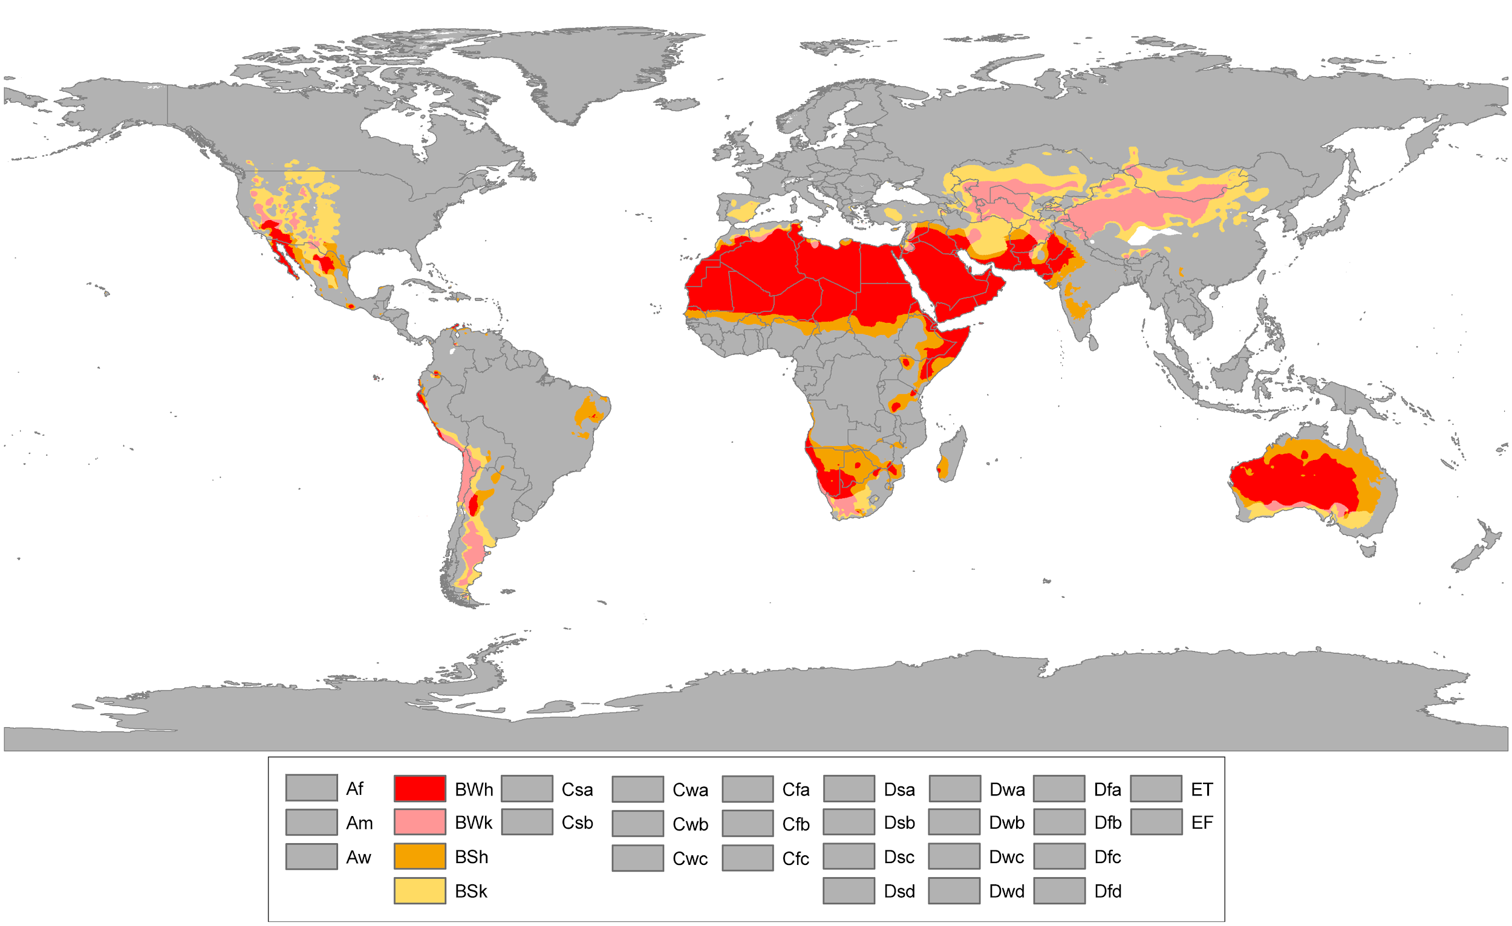
Dry Climates
Koppen’s Classification
Bsh - Subtropical Steppe Climate
Bwh - Subtropical Desert Climate

Slide 10
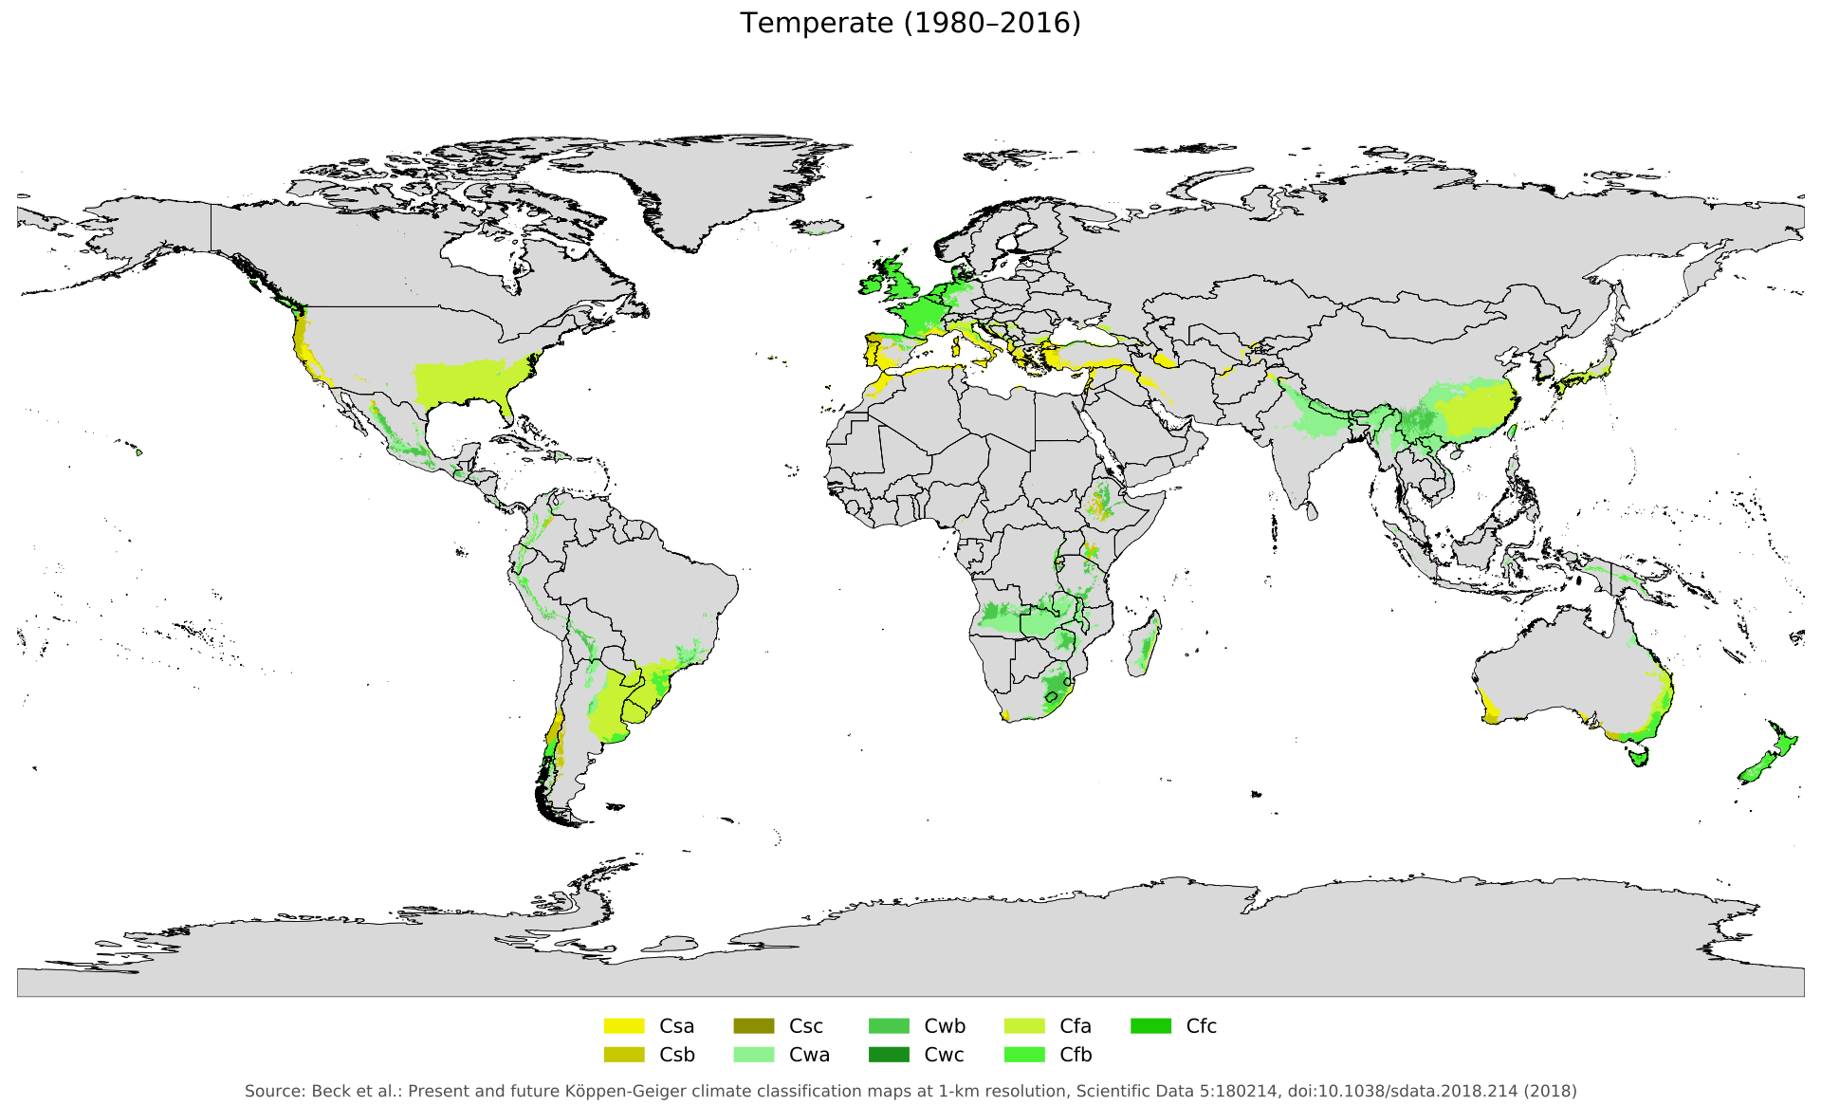
Warm Temperate Climate
Koppen’s Classification
Cwa - Humid Subtropical Climate
Cs - Mediterranean Climate
Cfa- Humid subtropical climate
Cfb - Marine West Coast Climate

Slide 11
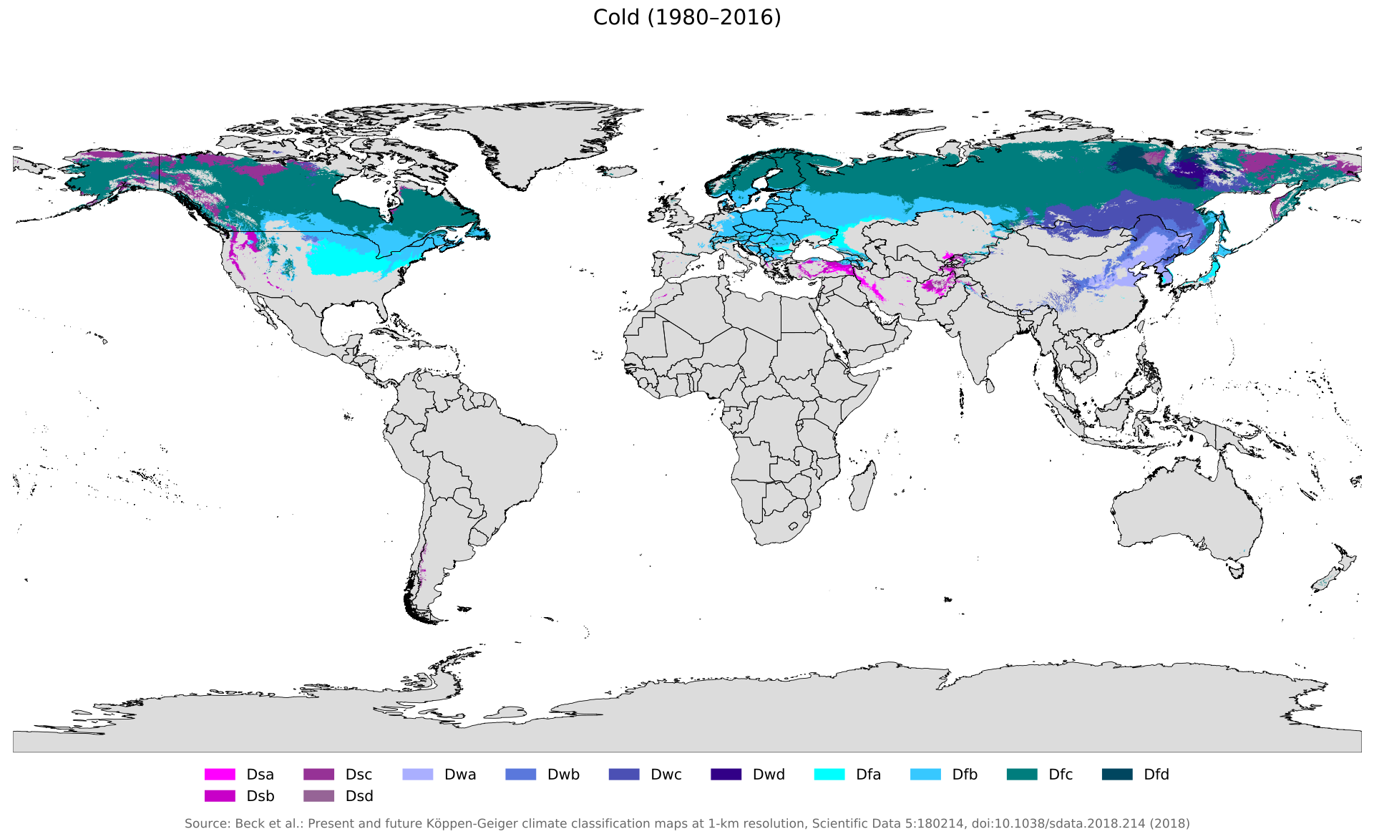
Cold Snow Forest Climate
Koppen’s Classification
Df - Cold Climate with Humid winter
Dw - Cold Climate with Dry Winter

Slide 12
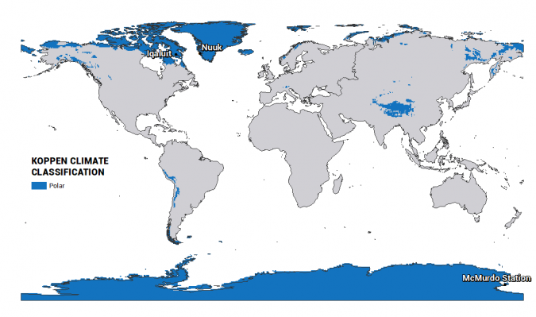
Polar Climate
Koppen’s Classification
ET - Tundra Climate
EF- Ice Cap Climate

