Slide 1
Rearrangement

Slide 2
Benzidine semidine Rearrangement
When hydrazobenzene is treated with acids (ethanolic HCl), it is converted into a mixture of benzidine (~75%) and diphenylene (~25%)
Study with wide variety of substituted hydrazobenzenes disclosed the formation of variety of products.
Aniline and azobenzene may also form by disproportionation.
2PhNH-NHPh 2PhNH2 + Ph-N=N-Ph
For example, p,p’-PhC₆H₄NH-NHC₆H₄Ph gives 88% disproportionation products at 25 ºC.

Slide 3
Substituent effect
Hydrazoarenes containing substituents at o-/m- positions give benzidines as major product on rearrangement while containing one or two substituents at p- position give side products.
If the p- position of one of the nucleus contains a +R group like –OMe, -Oet, the o-semidine type compound is the major product along with small amount of p-semidine.
b) If the p- position of one of the nucleus contains a –I group, a diphenylene type compound and the o-semidine type compound is formed.
c) If both p-positions are blocked, the major product is o-semidine type compound.
d) When p-position (one or both) is blocked by carboxyl or sulfonic acid group, the group gets ejected and benzidine is formed

Slide 4
Mechanism
The rearrangement is intramolecular and has been proved by crossover experiments. For example 2,2-dimethoxyhydrazobenzene and 2,2-diethoxyhydrazobenzene gives corresponding 3,3-dimethoxybenzidine and 3,3-diethoxybenzidine. NO cross-products was observed.
Hammond and Shine have shown that the benzidine and semidine rearrangement follows a 3rd order reaction, i.e.-
Rate = k[substrate].[H⁺]²
Therefore it is clear that the rearrangement proceeds via an intermediate which contains two protons.
Hammond et al. showed that p,p’-dideuterio hydrazobenzene rearrange at the same rate as that of hydrazobenzene. It therefore appears that the breaking of C-H bonds occurs after and not during the rate determining step.

Slide 5
Mechanism
From the evidences the mechanism of the rearrangement can be drawn as follows:

Slide 6
Examples

Slide 7
Claisen rearrangement
The rearrangement of allyl aryl ether allyl phenol is known as Claisen rearrangement. This reaction proceeds under heating and without any catalyst. The allyl group migrates to one of the ortho-positions if free. If both the ortho-positions are occupied, then only the migration happens to para-position.
The Claisen rearrangement is an exothermic reaction.
There are substantial solvent effects observed in the Claisen rearrangement, where polar solvents tend to accelerate the reaction to a greater extent. Hydrogen-bonding solvents gave the highest rate constants. For example, ethanol/water solvent mixtures give rate constants 10-fold higher than sulfolane.
This rearrangement is a concerted (bond cleavage and recombination) pericyclic reaction. Woodward–Hoffmann rules show a suprafacial, stereospecific reaction pathway.

Slide 8
Mechanism
Heating a mixture of two different allyl aryl ethers (1 and 2) together doesn’t give any cross product (5, 6). Therefore, it follows an intramolecular reaction pathway. This is further supported by first order reaction kinetics.
Cross products
In the intramolecular process, the reaction proceeds through a cyclic T.S. where new C-C bond forms and at the same time old C-O bond cleaves. Thus for ortho migration

Slide 9
Mechanism
When the ortho positions are blocked, the first step is still the ortho migration leading to a cyclohexadieneone (I). Lacking a H atom at the ortho position, prevents the aromatization of 1 and hence it undergo a further rearrangement by allyl group migration via a deformed six member T.S. (II), which finally aromatizes to give a para-substituted allyl phenol.
Experimental evidences
1. The intermediate cyclohexadieneone (I) is trapped by Diels-Alder reaction.
2. When an allyl ether labeled with ¹⁴C atom (γ carbon) is subjected to Claisen rearrangement, it is found that the γ−carbon atom forms bond in the ortho-position whereas the α−carbon atom forms the bond in the para-position.

Slide 10
3. It was further demonstrated that when ¹⁴C labeled allyl-2,6-diallyl phenyl ether (III) was subjected to Claisen rearrangement, the labelled ¹⁴C atom was equally distributed to ortho- and para-rearranged products (IV & V).
4. When the substrate VI containing ¹⁴C labelled allyl group is subjected to Claisen rearrangement and and the product is degraded, we get formaldehyde which does not show radioactivity, but the other product of degradation (VII) retains total activity. If the α−carbon instead of γ−¹⁴C were migrated, the degraded formaldehyde would have been radioactive. Thus the above experiments shows that the γ−carbon atom migrates in the Claisen rearrangement.

Slide 11
Examples
Out of Claisen
rearrangement
5)
Explain which product will form and why?
Product 1 is formed through T.S.-1 and product 2 is formed through T.S.-2. The T.S.-2 is energetically less favorable as in this case no ring is aromatic and hence less stable.

Slide 12
Examples
6)
7)
The isotope is equally distributed between the terminal methylene groups in the para-product
8)
In this example the stereocenter at C-1 is completely transferred to newly generated stereocenter at C-3. During the migration of the σ-bond, it remains on the same side of the cyclohexane ring. This type of stereocontrolloed transformation of a stereocenter into a new one is termed as chirality transfer and in this case, it is a 1,3-chirality transfer.

Slide 13
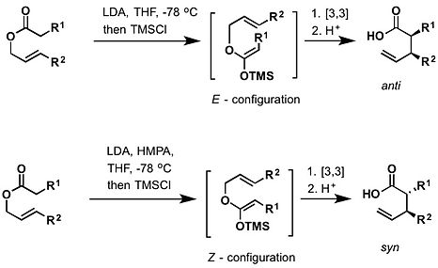
Ireland–Claisen rearrangement
The Ireland–Claisen rearrangement is the reaction of an allylic carboxylate with a strong base (such as lithium diisopropylamide) to give a γ,δ-unsaturated carboxylic acid. The rearrangement proceeds via silylketene acetal, which is formed by trapping the lithium enolate with chlorotrimethylsilane.
Ireland-Claisen rearrangement can take place at room temperature and above.
The E- and Z-configured silylketene acetals lead to anti and syn rearranged products, respectively.

Slide 14
Aza–Claisen (or amino Claisen)
This is actually a nitrogen analogue of simple Claisen rearrangement.
An iminium can serve as one of the pi-bonded moieties in the rearrangement.
Overman rearrangement
The Overman rearrangement is a Claisen rearrangement of allylic trichloroacetimidates to allylic trichloroacetamides.

Slide 15
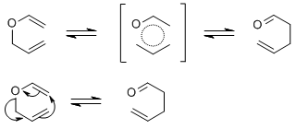
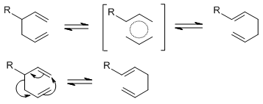
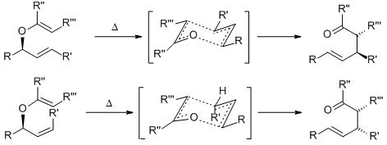
Claisen-Cope rearrangement
Claisen rearrangement is also given by allyl vinyl ether and in this case the rearrangement is known as aliphatic Claisen rearrangement or Claisen-Cope rearrangement.
The reaction proceeds preferably via a chair transition state. Chiral, enantio-pure starting materials give high enantio-pure product.
A boat transition state is also possible, and can lead to side products:

