Slide 2
A number of aromatic rearrangement occurs in aromatic system of the type
X is most commonly nitrogen, and in some cases oxygen atom.
Both intramolecular and intermolecular rearrangements are known
Z = -NO₂ / -­­NO (Fischer-Hepp) / -SO₃H / -N=N-Br
-OH (Bamberger)
-R (Hofmann-Martius)
-NHBr (Benzidine-Semidine)
-Cl and R = COCH₃ (Orton)

Slide 3
Fischer-Hepp Rearrangement
The rearrangement of a N-nitroso derivative of a secondary aromatic amine, under acid catalyst, to a para-nitroso product as a major one along with ortho isomer is known as Fischer-Hepp Rearrangement.
Evidence for intramolecular rearrangement:
When the reaction is carried out in 15N labeled sodium nitrite, no 15N was incorporated in the product. This suggests that the rearrangement is intramolecular.
Mechanism:

Slide 4
Hofmann-Martius Rearrangement
The thermal rearrangement (200-300 ºC) of hydrochloride salt of N-alkylaniline to C-alkylaniline is known as Hofmann-Martius rearrangement.
Mechanism:
The rearrangement is intermolecular, as during the reactions cross products are found
Examples:

Slide 5
N-Azo to C-azo Rearrangement
When the para- position is blocked, then only ortho product is obtained.
Mechanism:
The rearrangement is intermolecular, as during the reactions cross products are found.

Slide 6
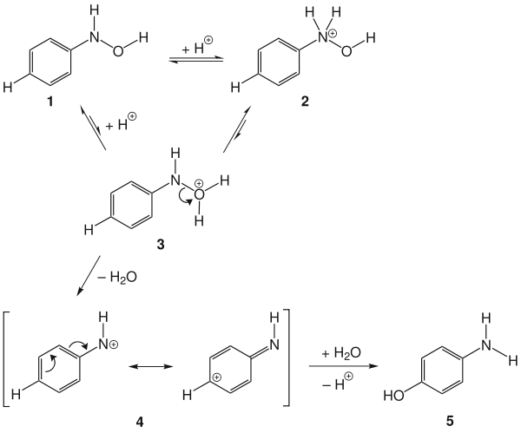
Bamberger Rearrangement
Aryl hydroxylamine, under acidic conditions, rearranges to form amino phenol. This type of rearrangement is known as Bamberger rearrangement.
The attack on the ring is not electrophilic, but nucleophilic.
Mechanism:
The mechanism of the rearrangement proceeds from the monoprotonation of N-phenylhydroxylamine 1. N-protonation 2 is favored, but unproductive. O-protonation 3 can form the nitrenium ion 4, which can react with nucleophiles (H₂O) to form the desired 4-aminophenol 5
When the reaction is carried out in presence of alcohol, alkoxy group is found in the product

Slide 7
Orton Rearrangement
Acid catalyzed rearrangement of N-chloro acetanilide to p-chloroacetanilide along with minor amount of o-chloroacetanilide is known as Orton Rearrangement.
The rearrangement is intermolecular
When air is bubbled through the reaction mixture, Cl₂ is evolved leaving anilide as the product.
Using HCl* (where -Cl* is radioactive) in the reaction, the –Cl* is found in the product.
When reaction is carried out in presence of anisole, o- and p- chloroanisoles are found as products.

Slide 8
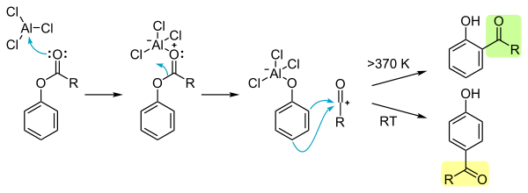
Fries Rearrangement
Phenolic esters on heating with anhydrous AlCl3, followed by hydrolysis , gives o- and p- acylphenols. This type of rearrangement is known as Fries rearrangement.
At low temp (<100 ºC) p-product predominates (KCP) and at high temperature (>100 ºC) o-product predominates (TCP).
The difficulty in the Fridel-Crafts acylation of phenols thus can be overcome by first acylation of phenol followed by heating with AlCl₃ to give o- and p- acyl phenols.

Slide 9
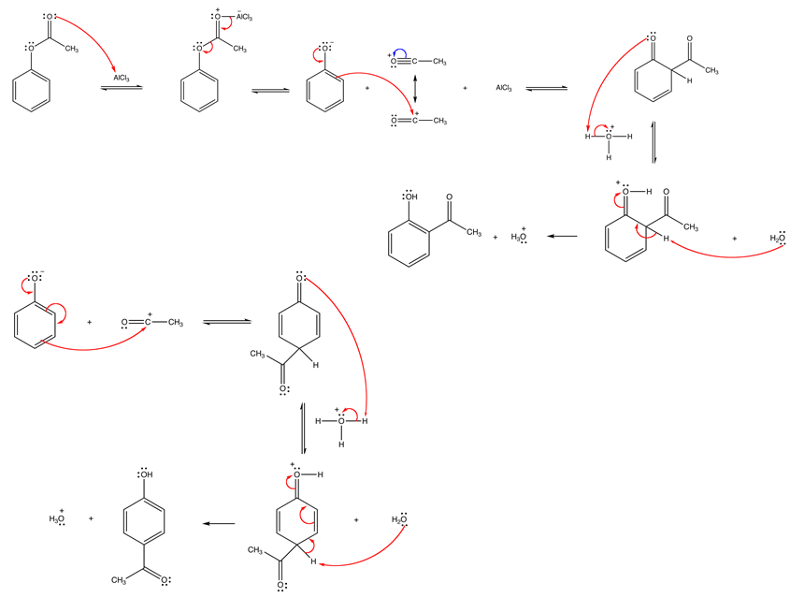
Fries Rearrangement
Mechanism
TCP
KCP

Slide 10
Para-isomer is formed more rapidly than the ortho-isomer due to steric reason. Hence at low temperature para-isomer is the major product and is KCP.
At high temperature, the reaction is equilibrium driven. Since the intermediate (before hydrolysis) of the ortho-isomer gets stabilized due to the chelation of two
oxygen atom with aluminium of AlCl_{3.} It is thermodynamically more stable
than the para-isomer and is the major product at high temperature (TCP).
Evidence for inter- and intramolecular mechanisms have been obtained
by crossover experiments with mixed reactants.
One step process has been demonstrated by rearrangement of two similar phenolic esters A and B in presence of toluene. Acylated toluene (cross-product) was obtained in case of A whereas no such acylated toluene was obtained in case of B, indicating the one step process for the later reaction.

Slide 11
Photo-Fries Rearrangement
Fries rearrangement can be done under ultraviolet light irradiation.
Photo-Fries rearrangement is an intramolecular process.

