Slide 1
Organic Chemistry
Rearrangement
Kuheli Pramanik
Department of Chemistry
Kharagpur College
Study material_Sem-IV
Paper – C10T
Lecture - 5

Slide 2
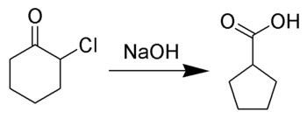
Favorskii rearrangement
α-halo ketones containing α’- H undergo base catalyzed rearrangement to give acid , ester or amine compound via a cyclopropane intermediate. This rearrangement is known as Favorskii rearrangement. If the base is a hydroxide, it produces acid whereas alkoxide and amine gives ester and amide respectively.
If the haloketone is a cyclic one, it gives a ring contraction product.

Slide 3
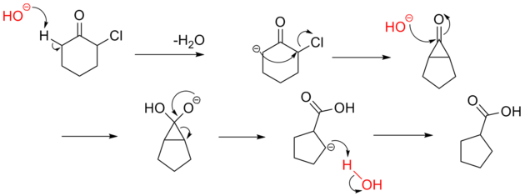
Mechanism
The reaction mechanism involves the formation of an enolate on the side of the ketone away from the chlorine atom. This enolate cyclizes to a cyclopropanone intermediate which is then attacked by the hydroxide nucleophile.
The direction of the ring opening of the cyclopropanone is determined by the formation of the more stable carbanion. Alkyl group destabilize the carbanion whereas aryl group stabilize the anion by delocalization

Slide 4
Evidence in support of Mechanism
1. The cyclopropane intermediate has been trapped as an adduct with furan
2. The two different starting material gives same product, which is possible only if it goes through same intermediate.
3. When 2-chlorocyclohexanone, labeled with C¹⁴ at the chlorine bearing carbon atom, treated with base it gives two products, half with C¹⁴ at α-cabon and half at β-carbon of the ester product which again proves the formation of cyclopropane intermediate.

Slide 5
When α-H is absent in a α-haloketone, benzylic acid mechanism takes place, which is known as quasi-favorskii reaction.
Favorskii rearrangement of α, α (gem) and α, α (vis) dihaloketone gives α,β-unsaturated ester.

Slide 6
Stereospecificity
The reaction is highly stereospecific as can be seen in the below example.
The formation of cyclopropane intermediate probably proceeds through an intramolecular 1,3-elimination involving a backside attack by the carbanion to the haloketone. Thus, cyclohexanone with equatorial halo atom undergo reaction whereas axial halo atom does not.

Slide 7
Examples
1.
2.
3.
4.

