Slide 1
Organic Chemistry
Rearrangement
Kuheli Pramanik
Department of Chemistry
Kharagpur College
Study material_Sem-IV
Paper – C10T
Lecture - 3

Slide 2
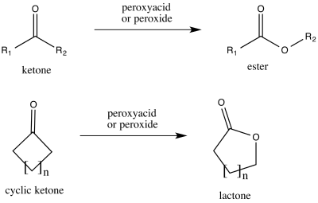
Baeyer–Villiger oxidation
The Baeyer–Villiger oxidation is an organic reaction that forms an ester from a ketone or a lactone from a cyclic ketone, using peroxyacids or peroxides as the oxidant. The reaction is named after Adolf von Baeyer and Victor Villiger who first reported the reaction in 1899.

Slide 3
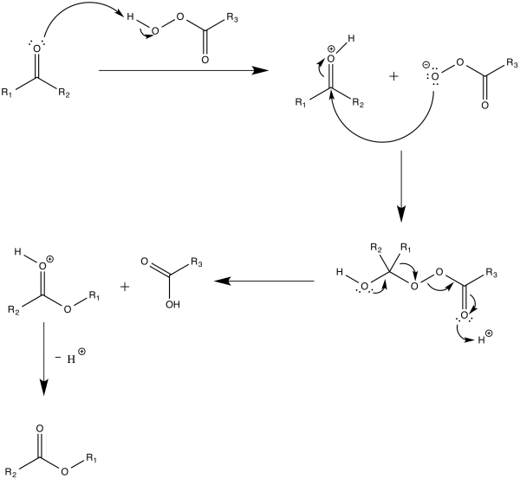
Mechanism
In the first step of the reaction mechanism, the peroxyacid protonates the oxygen of the carbonyl group. This makes the carbonyl group more susceptible to be attacked by the peroxyacid. Next, the peroxyacid attacks the carbon of the carbonyl group. Through a concerted mechanism, one of the substituents on the ketone migrates to the oxygen of the peroxide group while a carboxylic acid leaves. This migration step is thought to be the rate determining step. Finally, deprotonation of the oxocarbenium ion produces the ester.

Slide 4
Migration aptitude
In presence of two different types of migrating groups, which group will migrate? One example gives the following result
Migration of –Ph group
–R group
-R =
-Me
-Et
-^{i}Pr
-^{t}Bu
Yield
90
87
33
2
Yield
0
6
63
77
The result shows that –^{t}Bu has the highest migrating aptitude than –^{i}Pr than –Et and –Me. This is roughly follows the stabilizing power of the group to a positive charge.
Hence the migration order for alkyl group follows as tertiary > secondary > aryl > primary.
Electron-withdrawing groups on the substituent decrease the rate of migration

Slide 5
Migration aptitude
Due to the difference in migration aptitude, Bayer-Villiger reaction is regioselective
L-Dopa
drug for the treatment of Parkinson disease
Thus following order for migration of substituted aromatic rings was found

Slide 6
Migration aptitude – The Reason
There are two explanations for this trend in migration ability. One explanation relies on the buildup of positive charge in the transition state. So, the substituent that can stabilize the positive charge best, would be most likely to migrate. The higher the degree of substitution, the more stable a carbocation generally is. Therefore, the tertiary > secondary > primary trend is observed.
The “+” charge in the T.S. is most stabilized by i-propyl group than methyl group. Hence isopropyl group favours migration than methyl group.

Slide 7
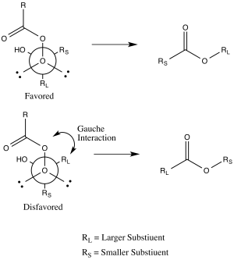
Migration aptitude – The Reason
Another explanation uses stereoelectronic effects and steric arguments. The substituent that is antiperiplanar to the peroxide group in the transition state will migrate. This transition state has a gauche interaction between the peroxyacid and the non-migrating substituent. If the bulkier group is placed antiperiplanar to the peroxide group, the gauche interaction will be reduced. Thus, the bulkier group will prefer to be antiperiplanar to the peroxide group, enhancing its aptitude for migration.

Slide 8
Examples
The reaction proceeds through Bayer-Villiger pathway, where –Ph migrates over –Me group, as –Ph can stabilize the “+” charge more efficiently than –Me group
If -Ph group migrates, the “+” charge will be destabilize by the –CO₂Et group. –Ph group can’t stabilize the intermediate due to lack of conjugation
If –CO₂Et group migrates, the “+” charge will be stabilize by the –Ph group.

Slide 9
Examples
The oxidation is extremely sensitive to steric and structural effects, as shown below. In the first two examples reaction only one product as per expectation. But in the last example both products are obtained.
Few more examples are given below
Retention of stereochemistry

Slide 10
CF₃CO₃H is generally the reagent of choice because the reactions with this reagent is very fast, gives very high yield of product. However this per acid sometimes gives some complications as a result of trans esterification, which takes place between the ester formed and the trifluoroacetic acid.
In order to avoid the complications, buffer such as Na₂HPO₄ is used in the reaction, which reacts with the trifluoroacetic acid to form a salt, hence minimize the chance of esterification.

