Slide 1
Molecular Spectroscopy
Introduction
Dr. Indranil Chakraborty
Department of Chemistry
Kharagpur College

Slide 2
SPECTROSCOPY
Interaction of Electromagnetic Radiation with matter (sample)
The study of molecular or atomic structure of a substance by observation of its interaction with electromagnetic radiation
QUANTITATIVELY - For determining the amount of material in a sample
QUALITATIVELY – For identifying the chemical structure of a sample

Slide 3
ΔE = hν
Molecular interaction with electromagnetic radiation
Electromagnetic radiation is absorbed when the
energy of photon corresponds to difference in
energy between two states.
Notes:
6

Slide 4
THE ELECTROMAGNETIC SPECTRUM
Most of us are aware of many different ways of transmitting energy and these phenomena come together in one physical entity called the ELECTROMAGNETIC SPECTRUM
The difference between these sources of radiation is the amount of energy they radiate.
The radiation from these and other sources covers a range of energies

Slide 5
Strength of radiation energy will interact with molecules in different ways
  High energy sources produce breaking of bonds
    X-Ray, γ-Rays
  Medium energy sources excite electrons
    UV / VISIBLE Spectroscopy
  Low energy sources produce vibrations in chemical bonds
    Infrared Energy
  Very low energy sources produce rotation of the chemical bonds
  Microwaves
  Further lower energy source produce inversion of nuclear spin state
    Radio waves

Slide 6
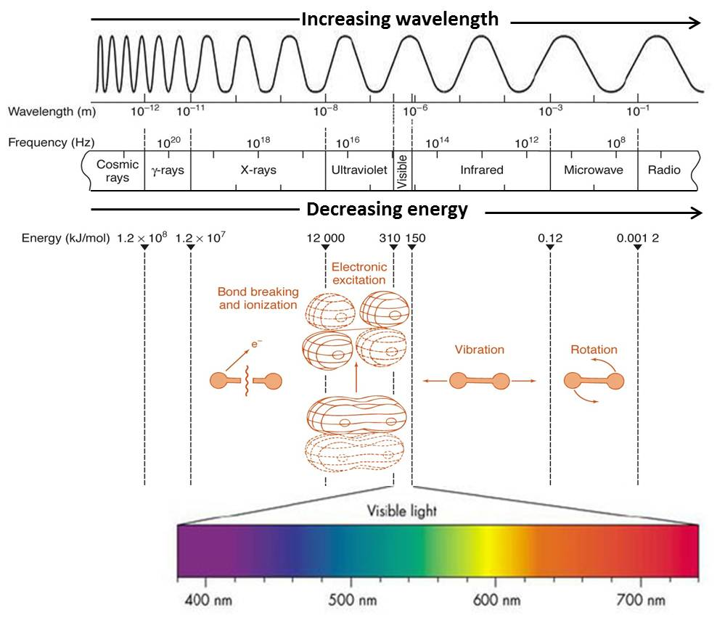

Slide 7
The Electromagnetic Spectrum
Gamma rays
X-rays
Ultraviolet
Visible
Infra-red
Microwave
Radio waves
Long
Low
Low
Wavelength
Energy
Frequency
Short
High
High

Slide 8
Molecules have electromagnetic fields derived from their electrons and nuclei
We saw earlier that plane-polarized light interacts by being rotated by an enantiomer
Energy varies across the spectrum and matches that required for various interactions.

Slide 9
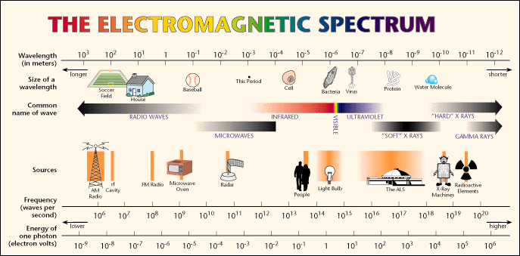
Where in the spectrum are these transitions?

Slide 10
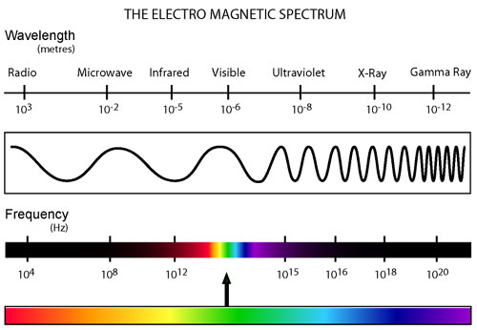
Radiowave: NMR
Microwave: ESR, EPR, Rotational Spectroscopy
Infrared: Vibrational spectroscopy
UV-Visible: Electronic Spectroscopy
UV-X-Ray: Photo Electron Spectroscopy
Gamma Ray: Mössbauer Spectroscopy

Slide 11
Energy increases going to the left
Ultraviolet and visible have sufficient energy to effect electronic transitions.
Infrared has sufficient energy only to effect transitions between vibrational energy states.
Microwave has only enough energy to effect transitions between rotational energy states.
Radio waves have insufficient energy to effect molecules but affect nuclear spin energy states found in magnetic fields. This latter interaction is most important because it is used in Nuclear Magnetic Resonance spectroscopy.

Slide 12
Emission Spectroscopy
Thermal or electrical excitation of atoms leading electrons to metastable state. The electrons jump to ground state releasing some energy as radiation. This radiation is analyzed with spectroscope. Ex: Fluoroscence, Phosphorescence
Absorption Spectroscopy
Substances are excited by electromagnetic radiation and energy of certain wavelength are absorbed by the substance which are characteristics of some functionalities. These missing wavelengths can be detected by allowing the light coming from the sample to fall on a photographic plate or other device. These pattern of spectral lines (corresponding to the wavelengths absorbed) are called absorption spectra. After absorption, the transmitted light is analyzed by a spectrometer relative to the incident light of given frequency.
Ex: UV-Vis, IR,NMR etc.

Slide 13
Spectroscopy | Energy levels | Selection rule
NMR/ ESR | Zeeman level | Δm = ±1 Ext B perp to B of light
Microwave | Rotational level | ΔJ = ±1 Molecule must be polar
Infrared | Vibrational level | ΔV = ±1 Dipole mom must change
UV-Vis | Electronic level | Spin selection rule Franck-Condon Principle

Slide 14
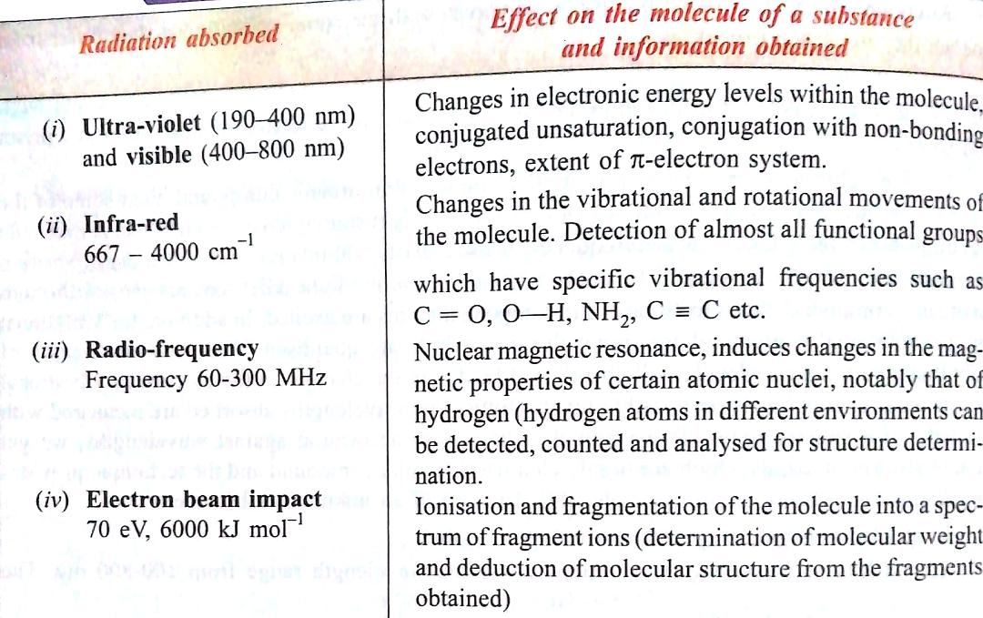
Spectroscopy (Molecular Absorption Spectroscopy)
Interaction of light with molecules

