Slide 1
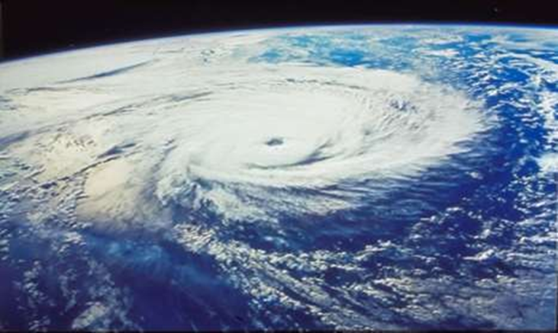
TROPICAL CYCLONE
CLASS: 3RD SEM
PAPER : CC5
UNIT: II-6
DONE BY : SK SAFIKUL HAQUE, geography Kharagpur college.

Slide 2
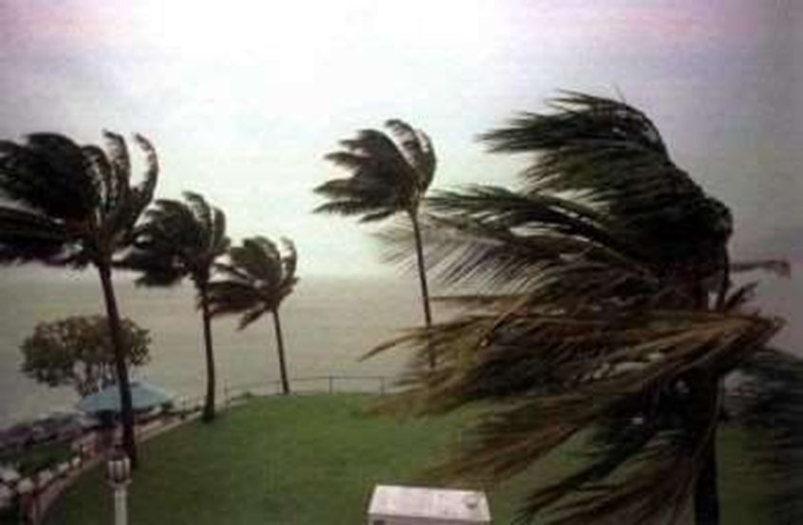
introduction
There is no climatic changes in tropical region.
There is a particular short season for wet-cold weather remain is hot and humid.
In a particular time and particular region on water bodies creates weather phenomena. Tropical cyclone is one of them.

Slide 3
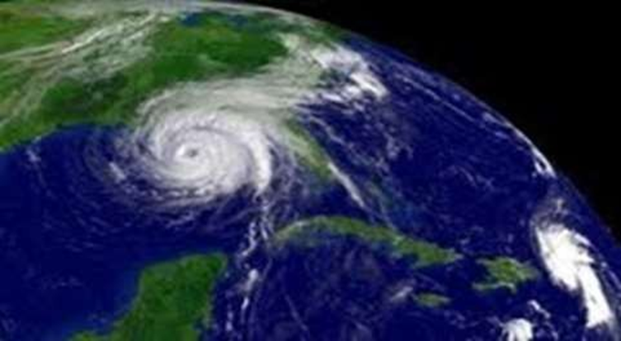
Concept and definition
A tropical cyclone is a storm system characterized by a large low-pressure center and numerous thunderstorms which is located from 5 degree to 10 degree both side of tropical region .
2. It has different names in different region.

Slide 4
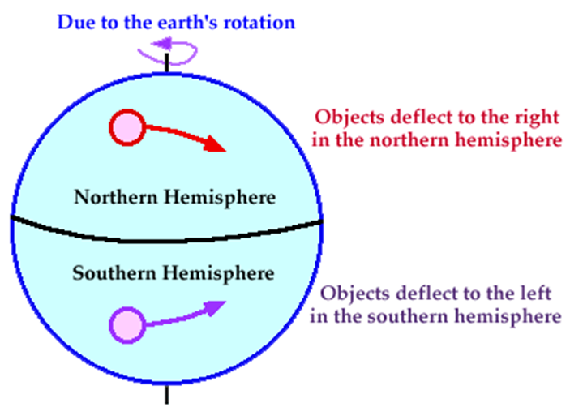
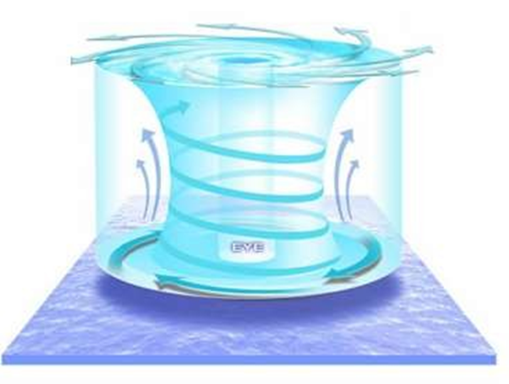
Controlling factors
Supply of sensible and latent heat
Depth of warm water
Presence of pre-existing low-level disturbances
Presence of disturbance in the upper atmosphere
Coriolis parameters
Minimum vertical wind shear
Divergence in upper troposphere
Exitance of high humidity level

Slide 5
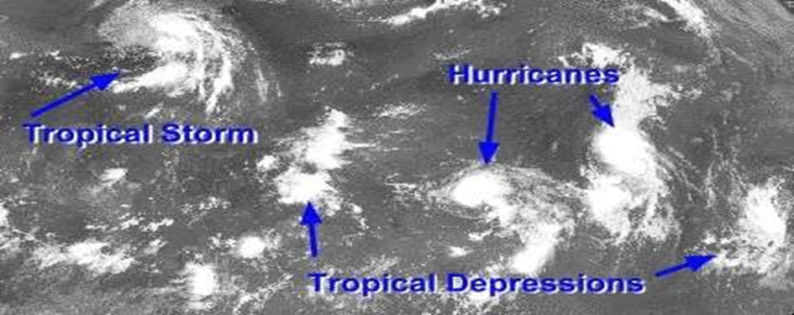
Classification of tropical cyclone
WAEK CYCLONE :- 3 types
a) Easterly Waves
b) Tropical Depression
c) Tropical Strom
2. SEVERE CYCLONE :-

Slide 6
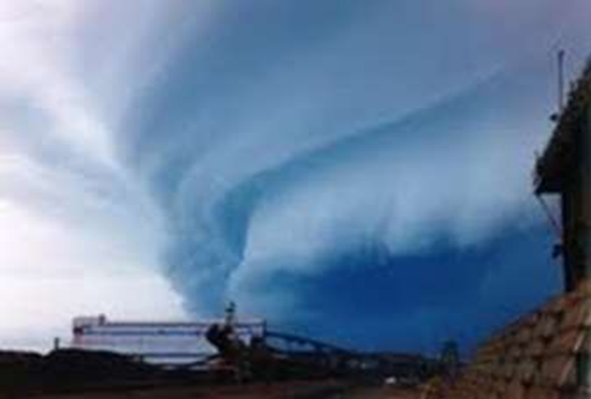
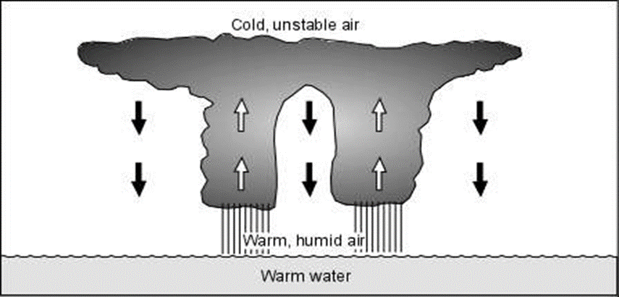
LIFE CYCLE OF TROPICAL CYCLONE
There are 4 phases of a Tropical Cyclone –
1. Initial Stage
2. Developing Stage
3. Mature Stage
4. Dissipating Stage

Slide 7
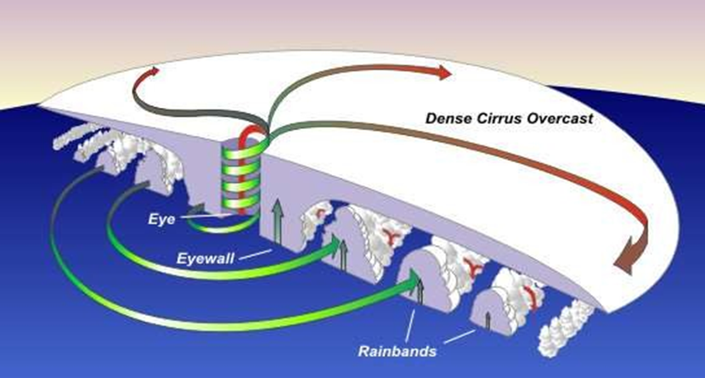
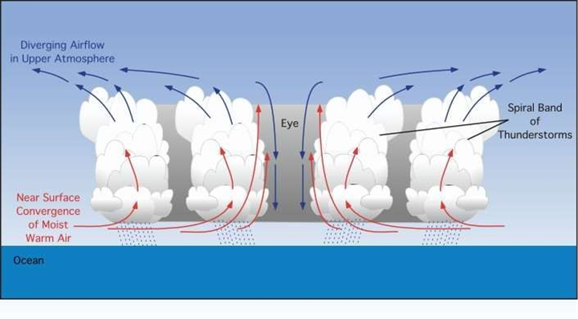
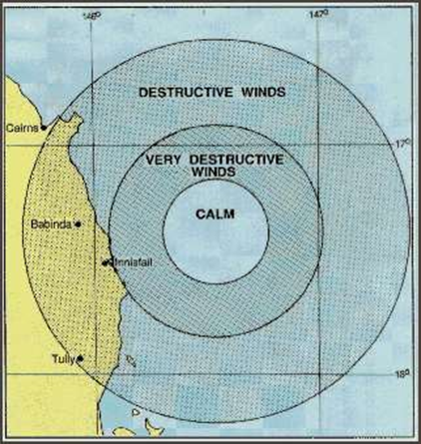
STRUCTURE OF TROPICAL CYCLONE
The Eye - the clear, calm center of storm
 Cool air descends into this center (downdrafts)
 Eyewall – ring of thunderstorms close to eye
 Eyewall produces the most devastating winds
 Rainbands – curved groups of clouds and thunderstorms
 Rainbands travel away from eye in a spiral motion

Slide 8
CITATIONS
(1) Australian Government Bureau of Meteorology. (2009). About Tropical Cyclones. Retrieved November 22, 2009, from http://www.bom.gov.au/weather/cyclone/about/about-tropical-cyclones.shtml
(2) https://www.slideshare.net/breannej35/the-physical-characteristics-of-tropical-cyclones
(3) Catto, N., Hyndman, D., Hyndman, D. (2009). Natural Hazards and Disasters. Toronto, ON: Nelson Education
(4) Earth Science Australia. (2009). Tropical Cyclones. Retrieved November 22, 2009, from http://earthsci.org/flood/J_Flood04/cyclone/cyclone.html
(5) National Weather Service. (2008, October 8). Tropical Weather. Retrieved November 22, 2009, from
http://oceanservice.noaa.gov/education/yos/resource/JetStream/tropics/tc.htm
(6) Nelson, S.A. (2009, October 30). Exceptional Weather – Tropical Cyclones. Retrieved November 22, 2009, from http://www.tulane.edu/~sanelson/geol204/tropical_cyclones.htm
(7) Tropical cyclone. (2009, November 22). In Wikipedia, The Free Encyclopedia. Retrieved November 20, 2009, from http://en.wikipedia.org/wiki/Tropical_cyclone
(8) WikiAnswers. (2009). How do cyclones form? Retrieved November 23, 2009, from
http://wiki.answers.com/Q/How_do_cyclones_form&alreadyAsked=1&rtitle=What_causes_cyclones

Slide 9
THANK YOU
ANY QUESTION

