Slide 1
COMPILER DESIGN BCA 5th Semester 2020 Topic: NFA and DFA
Sakhi Bandyopadhyay
Department of Computer Science and BCA
Kharagpur College

Slide 2
Non-Deterministic Finite Automata (NFA)
Non-Deterministic Finite Automata is defined by the quintuple-
M = (Q, ∑, δ, q0, F)
where-
Q = finite set of states
∑ = non-empty finite set of symbols called as input alphabets
δ : Q x ∑ → 2Q is a total function called as transition function
q0 ∈ Q is the initial state
F ⊆ Q is a set of final states

Slide 3
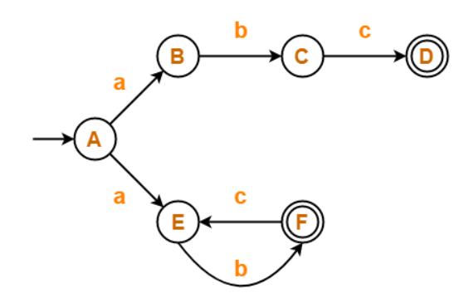
Non-Deterministic Finite Automata (NFA) (Cont.)
Example
Q = finite set of states = {A, B, C, D, E, F}
∑ = input alphabets = {a, b, c}
δ : Q x ∑ → ${\text{2}}^{\text{Q}}$ is the transition function
q0 ∈ Q = the initial state = A
F ⊆ Q is a set of final states = {D, F}

Slide 4
Deterministic Finite Automata (NFA)
A DFA is a collection of 5-tuples same as we described in the definition of FA.
M = (Q, ∑, δ, q0, F)
Q: finite set of states
∑: finite set of the input symbol
q0: initial state
F: final state
δ: Transition function δ: Q x ∑→Q

Slide 5
Deterministic Finite Automata (NFA)
Example
Q: finite set of states = {q0, q1, q2}
∑: finite set of the input symbol = {0, 1}
q0: initial state = {q0}
F: final state = {q2}
δ: Transition function δ: Q x ∑→Q
Present State | 0 | 1
→q0 | q0 | q1
q1 | q2 | q1
*q2 | q2 | q2

Slide 6
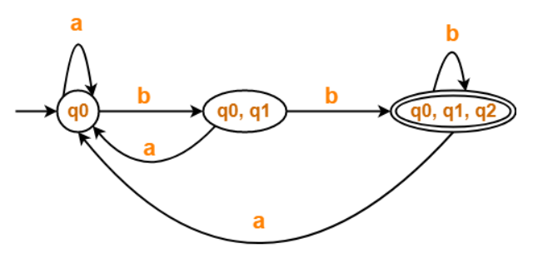
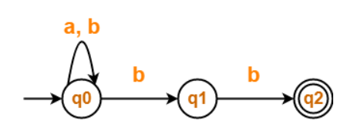
Example 1 NFA to DFA Conversion
NFA DFA
State / Alphabet | a | b
→q0 | q0 | q0, q1
q1 | – | *q2
*q2 | – | –
State / Alphabet | a | b
→q0 | q0 | {q0, q1}
{q0, q1} | q0 | *{q0, q1, q2}
*{q0, q1, q2} | q0 | *{q0, q1, q2}

Slide 7
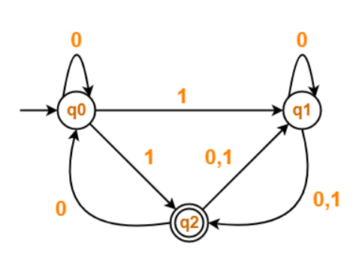
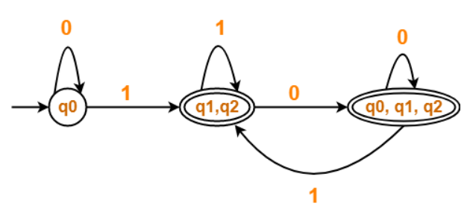
Example 2 NFA to DFA conversion
NFA DFA
State / Alphabet | 0 | 1
→q0 | q0 | q1, *q2
q1 | q1, *q2 | *q2
*q2 | q0, q1 | q1
State / Alphabet | 0 | 1
→q0 | q0 | *{q1, q2}
*{q1, q2} | *{q0, q1, q2} | *{q1, q2}
*{q0, q1, q2} | *{q0, q1, q2} | *{q1, q2}

Slide 8
Thank You

