Slide 1
Statistical Geography -4
Class – 3rd Sem Date – 27/08/2020
Paper – C6T Unit – II -3 (Partial)
By – Sandip Tripathy, Department of Geography, Kharagpur College
Topic Covered – spearman’s Rank Correlation

Slide 2
Data Correlation
Sorts of relationship between two things with quantification of intensity between two things.
This may or may not be direct relationship between things
It may be causation only
No dependent, independent relationship between variables
Example – unhealthy food leads to ill-health

Slide 3
Rank Correlation by Spearman
It is a type of ordinal correlation
It is generally calculated based on Rank
It generally measures the association between two rankings

Slide 4
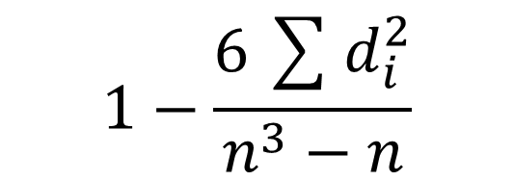
Formula of spearman’s rank correlation

Slide 5
Calculation

Slide 6
Advantages and Disadvantages
It is easy to calculate and to understand.
It can be useful for both dependent and independent variables
It is a non-parametric measure, so it can be useful for the variables that have less number of observation
As it is only deal with the rank, so no complex calculation with large data are not needed.
It can not estimate population parameter (unlike pearson’s PP)
It is used for ordinal and continuous type of data

Slide 7
Thank you
Have questions, ask here

