Slide 1
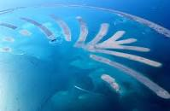
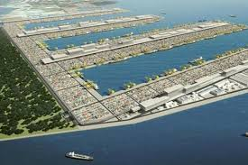
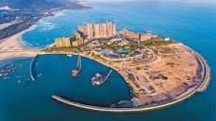
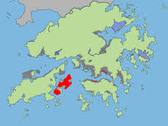
ONLINE CLASS FOR 3RD SEMESTER,2020
Land reclamation
Presented by-
Dinabandhu Patra
Department of Geography
Kharagpur College

Slide 2
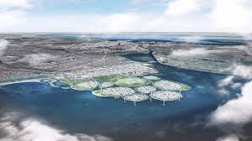
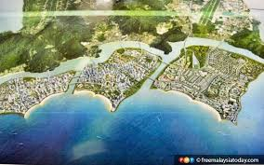
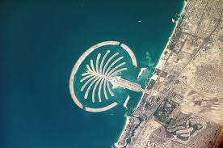
Introduction:
Land reclamation is the process of creating new land from the sea. It is a process of improving lands to make them suitable for a more intensive use also it is the process of creating new land from oceans, seas,
riverbeds or lake beds, deserts etc.

Slide 3
Spatial Difference of meaning of land reclamation:
Land reclamation also known as land fill. In USA the term "reclamation" can refer to returning disturbed lands to an improved state.
Alberta, Canada, for example, reclamation is defined by the provincial government as "The process of reconverting disturbed land to its former or other productive uses.“
Oceania it is frequently referred to as land rehabilitation.
Source: https://en.wikipedia.org/wiki/Land_reclamation

Slide 4
Brief History of land reclamation:
Land reclamation is not applying for sea but also related with desert, fallow land, lake body, river beds etc. So the history of land filling is not a modern days view. Land reclamation from the sea has been occurring since ancient time. Especially in most of the world's docks in present day occupy spaces that were once water.
In Northeast China since 1900 people has a great effort to reclaim land from sea.

Slide 5
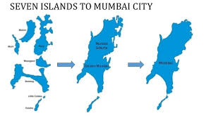
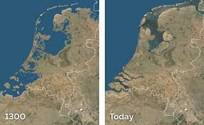
Cont.
In northern Italy and Northern Holland (Netherland) it has So long history.
In Pre industrial period it presence found in Europe.
In Bombay (India) the early land reclaim was mostly seen in first decade of eighteen Century.
Holland/ Netherland
Source: Quora.com
Colonial period more rural People came to Coastal area in Europe.
image Source: https://www.earthmagazine.org/article/dutch-masters-netherlands-exports-flood-control-expertise

Slide 6
Land reclaim methods:
Land reclamation in different way-
Filling the area with large amounts of heavy rock and/or cement, then filling with clay and dirt until the desired height is reached.
After draining submerged wetlands it often used to reclaim land for agricultural use.
Deep cement mixing is used typically in situations in which the material displaced by either dredging or draining may be contaminated.

Slide 7
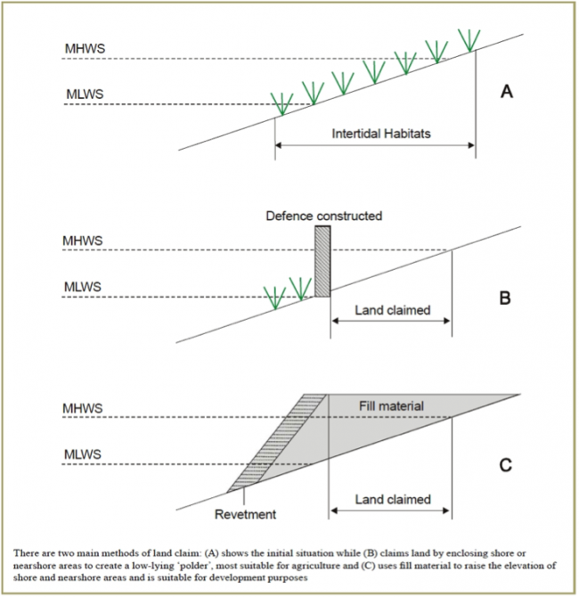
Cont..
4. Land dredging is also another method of land reclamation. It is the removal of sediments and debris from the bottom of a body of water.
5. Some Structural method like construction of revetment and filling up the zone.
Image Source::http://www.asiapacificadapt.net/adaptation-technologies/database/land-reclamation

Slide 8
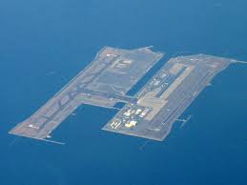
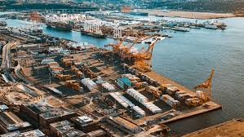
Purposes of Land reclamation:
Beach rebuilding is the process of repairing beaches can make land filling. example- Mumbai
Human overcrowding of developed areas intensified during the 20th century.
Some of the most common usages are for industrial uses, tourism spot, office buildings, parks, golf courses and other sports fields, air port, harbour etc.
Fish culture: Another use of such enclosed land is the creation of fish ponds (e.g., Pearl River Delta and Hong Kong).

Slide 9
Environmental Impacts of land reclamation:
The need for space to accommodate an increasing world population, which is projected to exceed 8.1 billion by 2025 (United Nations, 2013). So due large scale coastal development activity lead serious environmental problems-
wetlands for ploughing, for example, is a form of habitat destruction.
Reclamation projects have strong negative impacts on coastal populations.
Reclaimed land is highly susceptible to soil liquefaction during earthquakes.
Drained marshes will eventually sink below the surrounding water level, increasing the danger from flooding.

Slide 10
According to Bryant et al. (1998), Dahuri et al, (2001), WRI (2001) and Fortes (2001), reclamation would alter the condition and ecosystem of the coastal area. In general, reclamation activities would influence several aspects :
1. Natural morphology of the beach and coastal area.
2. Coastal biological resources, like fisheries and other coastal biota.
3. Sediment area in the reclaimed location.
4. Mangrove and reefs.
All information in this page is retrieved from Ref-1 (Priyandes & Majid, 2009)

Slide 11
Physical disturbance Reclamation of sea land can lead to many negative effects, such as-
The decreased the space of tide.
Disappeared the beach.
Lost wave energy dissipation space.
Increased influx of disaster risks and filled up riverbed.
Flow outside the channel slows down.
Frequency and intensity of alga bloom increase.
Materials and pollutants generate during the reclamation activities and they can pollute the marine environment.
The beach and barrier disappear.
The impact of waves on coastal areas will be further increased.
Change of bathymetry at the waters around the reclamation area
Reclamation of marine, causing shoreline change.
Affected the deposition of sediments.

Slide 12
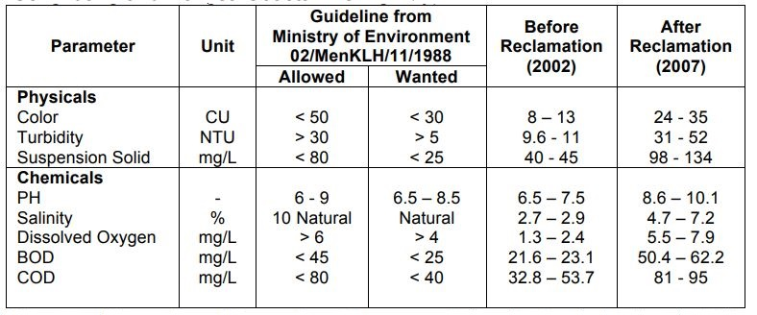
Sea Water Quality around Bengkong, Batam Center and Surrounding area in Indonesia
Fig- water quality of some area of Indonesia
Source- This data retrieved from Ref.-1 (Priyandes & Majid,2009 )

Slide 13
Cont…
Water
Large-scale reclamation can also affect the regional groundwater regime.
Less amount of water infiltrate due to over flow.
If ground water increased then less chance of additional water storage, flood can occur from aquifers.
Fishery
Large-scale reclamation projects cause the changes of topography and water in gulf, that can affect the fisheries resources directly.
Rapid development of industry and population are continue to generate a large number of pollutants discharged into the sea, that affect the regeneration capacity of fishery resources and marine aquaculture industry.

Slide 14
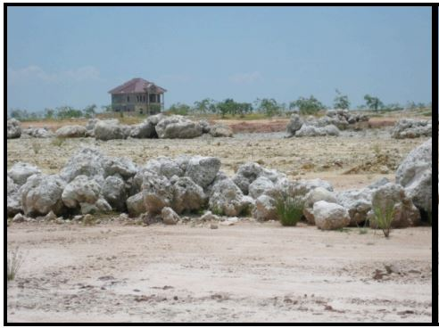
Habitat
The destruction of wetlands (migratory bird loss their habitation)
Marine biodiversity damage
Coral reef destruction due to pollution
Loss of the land on the coastal zone often leads to the rapid decrease of biodiversity, especially on the uplifting regions.
Injuring fish by irritating or scouring their gills
Mangrove loss
Fig-Dead Coral around the reclamation area, Source-ref.-1
Soil/Sediment
Removing the vegetation for coastal development can increase coastal erosion.
The consequence of increased sediment input is elevated coastal and estuarine turbidity.
The decreased sediment load contributes to loss of wetlands in the delta(opposite condition of above).
Diversion of sediment pathways through dam building, port/harbour construction or any infrastructure development, any constructed on dunes and sand spits may result in losses following coastal erosion.

Slide 15
International Condition of land filling
Different countries land reclaim conditions are described here-
Country | Area reclaimed | % in respect of total area | Remarks
Bangladesh | 110 square km. | 8% of total area | -
Netherlands | 7,000 square km. | 17% of the entire country | -
Singapore | 20 percent of the original | 17 square kilometers | as of 2003, plans for 99 square kilometres
Macau | 17 square kilometres | 170% of original Size
United Arab Emirates | Dubai has a total of four reclaimed islands the Palm Jumeirah, Jebal Ali, The Burj al Arab Island, and The World Islands
Kobe, Japan | 23 square kilometres |  | 1995
Bahrain | 410 square kilometers | 76.3% of original size of | 1931–2007
Source: https://en.wikipedia.org/wiki/Land_reclamation

Slide 16
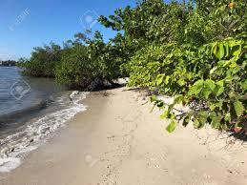
Management

Slide 17
Proper management of land Reclamation to protect environment
People are very greedy to meet their needs, it go beyond the threshold level of Environment.. Land reclamation also a process that hampering the environment normal condition. To work development we need to obey some rules and regulation . The object of the guidelines is to minimize the impacts of reclamation on coastal habitats and coastal water quality.

Slide 18
Sediment and Erosion Control
Protection of fresh and marine water quality in the surrounding environment is one of the major concerns when reclaiming land in coastal areas. Avoid extraction of mangrove mud where possible.
Construction activities associated with reclamation may cause indirect siltation and sediment movement.
Wave breaking zone are affected the hydrodynamics of the marine environment which may lead to erosion of adjacent foreshores and siltation of waterways. Excessive siltation may impact on local marine life specially mangroves, molluscs, fish.
The best way to minimize changes to hydrodynamics of an area are
Retain the existing natural environment at the land/sea interface.
The natural vegetation is retained to assist foreshore stabilization.
Some areas may benefit by recolonization of mangroves in previously disturbed areas.

Slide 19
Avoid the unsuitable material for land filling
Examples of material unsuitable for fill are as follows:
• liquid waste including sludge and grease trap waste
• pesticides and pesticide containers
• hazardous wastes including asbestos, radioactive material and medical wastes
• household and commercial garbage, putrescibles (eg. Plastics, cardboard/paper, kitchen wastes, carcasses)
• timber, corrugated iron and other metals
• vegetation (depending on the purpose of the reclamation
• oil drums and plastic container and gas bottles
• car bodies and tyres

Slide 20
Dust Management
Dust management is an important environmental and public health issue on development sites during the dry season. The generation of dust is dependent on the soil/geological conditions and on the local weather.
This can be achieved by:
ensuring reclamation and construction activities take into consideration the local wind conditions.
• Minimizing vegetation clearance.
• revegetating areas that are no longer required for reclamation or construction.
• ensuring that unsealed roads and exposed areas are watered at all times.
• applying speed restrictions.

Slide 21
Fire Management
Burning of waste can be a significant environmental hazard which has pollution, safety and nuisance implications. Burning-off is not permitted anywhere . Burned ash also mixed with sea water some-crate a hazard conditions.
Site security and supervision
The acceptance and placement of reclamation materials should be supervised to prevent unauthorized dumping of wastes and unsuitable fill material. In addition, foreshore lands are generally highly vulnerable and poor management may lead dangerous conditions. Where, already industry developed there must be a industrial security system with regular checkup of various hazardous material.

Slide 22
Coastal Regulation Zone act The powers conferred by Environment (Protection) Act, 1986 (29 of 1986). By the act some prohibition mentioned in Coastal Regulation Zone. “Land reclamation, bunding or disturbing the natural course of sea water except those required for construction or modernization or expansion of ports, harbours, jetties, wharves, quays, slipways, bridges and sea-links and for other facilities that are essential for….. .” “Provided that reclamation for commercial purposes such as shopping and housing complexes, hotels and entertainment activities shall not be permissible."

Slide 23
Monitoring and measurement to minimize the impact on environmental
SEABED SAMPLING
SEABED MONITORING
BEACH MONITORING
CURRENT MEASUREMENT
WAVE MEASUREMENT
WATER QUALITY MEASUREMENT
SUSPENDED SOLID TEST
SILT BARRICADE

Slide 24
References:
Priyandes, A., & Majid, M. R. (2009). Impact of reclamation activities on the environment case study: reclamation in northern coast of Batam. Jurnal Alam Bina, 15(1).
https://nt.gov.au/__data/assets/pdf_file/0011/228989/environmental- guidelines.pdf
Folorunsho, R., Green, S., ... & Kim, T. K. (2016). Land-Sea Physical Interaction. United Nations From. https://www. researchgate. net/publication/291958268_Chapter_26_Land-Sea_Physical_Interaction.
Ge, Y., & Jun-yan, Z. (2011). Analysis of the impact on ecosystem and environment of marine reclamation--A case study in Jiaozhou Bay. Energy Procedia, 5, 105-111.

Slide 25
Thank You

