Slide 1
Statistical Geography - 5
Class - 3rd sem Paper - CC6
Unit -2 -3 Date - 29/08/2020
By - Sandip Tripathy, Department of Geography

Slide 2

Formula of Spearman’s Rank Correlation
1-6Σd^2/n^3-n

Slide 3
Correlation
Agricultural Production (Quintal) | Pesticides Used (Kg)
45 | 20
75 | 40
35 | 25
120 | 70
25 | 10
55 | 30
85 | 25
150 | 45
200 | 55

Slide 4
Table - 1 = Calculation for Correlation
Agricultural Production (Quintal) | Rank (x) | Pesticides Used (Kg) | Rank (Y) | .d = Rank x - Rank y | d^2
45 |  | 20
75 |  | 40
35 |  | 25
120 |  | 70
25 |  | 10
55 |  | 30
85 |  | 25
150 |  | 45
200 |  | 55

Slide 5
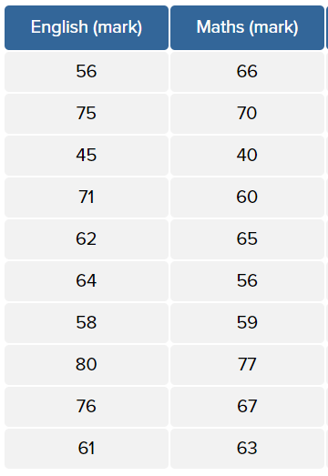
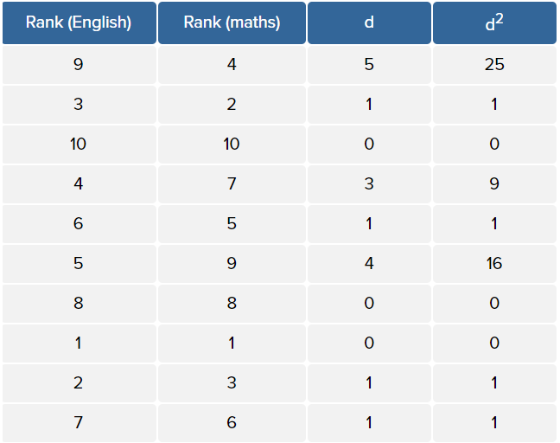
Further Problem

Slide 6
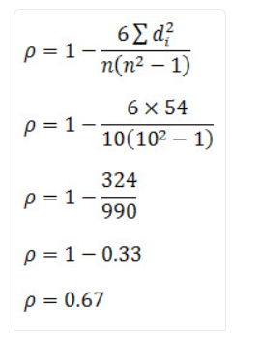

Slide 7
Thank you
Have a questions? Ask Here

