Slide 1
ONLINE CLASS FOR 3RD SEMESTER,2020
Layers of the earth’s Atmosphere
Presented by-
Dinabandhu Patra
Department of Geography
Kharagpur College

Slide 2
Introduction:
The atmosphere can be divided conveniently into a number of rather well-marked horizontal layers, mainly on the basis of temperature. Scientist are understood and makes idea from the various sources like balloons, radio wave investigations, and, more recently, from rocket flights, radar wind-sounding, satellite sounding systems etc..
There are three relatively warm layers situated in our atmosphere one above another- (near the surface; between 50 and 60 km; and above about 120 km) separated by two relatively cold layers (between 10 and 30 km; and 80 and 100 km) .

Slide 3
Troposphere:
The lowermost layer of the atmosphere is called the troposphere. weather phenomena and atmospheric turbulence are take place here. This layer contains 75 percent of the total molecular or gaseous mass of the atmosphere and virtually all the water vapour and aerosols.
Important characteristics-
Bottom layer of atmosphere, weather phenomena happens, clouds form, air moves a lot here
from earth’s surface it expand nearly about 12 kilometers altitude(0 to 7.5 miles)
Gets colder with increasing altitude…to about -55⁰ C (-67⁰ F) at the top of troposphere.
Tropopause- .This inversion level or weather ceiling is called the tropopause boundary between the troposphere, and the stratosphere is called the tropopause. Its height is not constant in either space or time.
It seems that the height of the tropopause at any point is correlated with sea-level temperature and pressure, which are in turn related to the factors of latitude, season and daily changes in surface pressure .

Slide 4
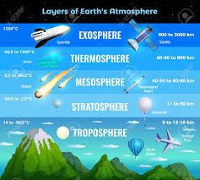
Cont…
There are marked variations in the altitude of the tropopause with latitude from about 16 km at the equator, where there is strong heating and vertical convective turbulence, to only 8 km at the poles. In mid latitude zone some interchange can occur between the troposphere and stratosphere, and vice versa. Traces of water vapour can penetrate into the stratosphere by this and and ,ozone-rich stratospheric air may be brought down into the mid-latitude troposphere (Barry & Chorley, 2009).
Image source; https://www.123rf.com/photo_145175946_stock-vector-earth-atmosphere-layers-infographic-info-chart-poster-with-troposphere-stratosphere-mesosphere-therm.html

Slide 5
Stratosphere:
In Stratosphere there are about 10 percent of the atmospheric mass. Although the stratosphere contains much of the total atmospheric ozone (it reaches a peak density at approximately 22 km). maximum temperatures associated with the absorption of the sun’s ultraviolet radiation by ozone occur at the stratopause. Some important characteristics are-
Stratosphere Extends from 10 km to 50 km above the ground.
Temperature increases with altitude
The air density is much lower here, so even limited absorption produces a high temperature rise.
Almost no weather occurrence Contains high level of ozone and ozone layer located nearly 15-35 km. height.

Slide 6
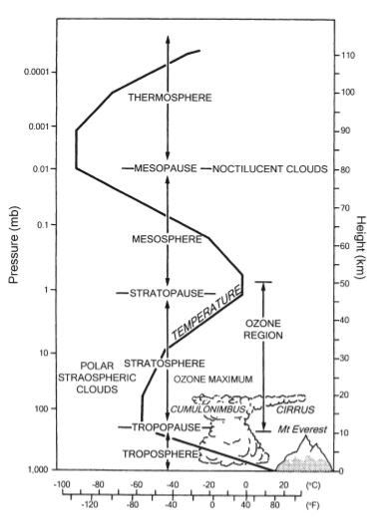
Cont…
Different layers of atmosphere
Low temperatures are found in the middle stratosphere at high latitudes, whereas over 50–60°N there is a marked warm region with nearly isothermal conditions at about –45 to –50°C.
Some time in polar area stratosphere in the Arctic often undergoes dramatically then temperature suddenly increased from 80 to –40°C.
There is no Climatic disturbance like rain, thunderstorm etc.
Stratopause-Upper boundary of stratosphere is called stratopause.It is located nearly 50 k.m from earth surface, here temperature is about 0°C.
Retrieved from(Barry & Chorley, 2009).

Slide 7
Mesosphere:
This layer is commonly termed the mesosphere, although as yet there is no universal terminology for the upper atmospheric layers. It extends up to almost 80-90km high. The layers between the tropopause and the lower thermosphere are commonly referred to as the middle atmosphere and upper atmosphere is known the regions above about 100 km altitude. Some important characteristics are-
Gases in this layer absorb very little UV radiation.
99.9% of mass lies below the mesosphere.
In 80 km. height of mesosphere temperature is nearly -85 °C
Gases are less dense, temperature decreases as altitude increases.

Slide 8
Cont..
Not enough oxygen to breathe but very % is still the same.
Most meteoroids burn up here…. the air is very thin, but still dense enough to slow down meteoroids due to friction.
There is not an ozone layer to cause heating so, temperatures decrease with altitude in the mesosphere.
Pressure is very low in the mesosphere, decreasing from about 1 mb at 50 km to 0.01 mb at 90 km.
It is in this region that noctilucent clouds are observed on summer ‘nights’ over high latitudes.
Mesopause- at the last limit of mesosphere is called Mesopause and this is also last limit of Homosphere.

Slide 9
Thermosphere:
Above the mesosphere and extends to almost 500 km high. Atmospheric densities are extremely low above the mesopause. Important characters are mentioned below-
Temperature increases with altitude and absorbs solar radiation
Temperature can go as high as 1,500 °C
The lower portion of the thermosphere is composed mainly of nitrogen (N2) and oxygen in molecular (O2) and atomic (O) forms.
whereas above 200 km atomic oxygen predominates over nitrogen.
Temperatures rise with height, owing to the absorption of extreme ultraviolet radiation (0.125 to 0.205 µm).

Slide 10
Cont…
The term ionosphere is commonly applied to the layers above 80 km.
The Aurora Borealis and Aurora Australis are produced by the penetration of ionizing particles through the atmosphere from about 300 km to 80 km, particularly in zones about 10 to 20° latitude .
Temperatures in the upper thermosphere undergo wide diurnal and seasonal variations.
Above 100 km, cosmic radiation, solar X-rays and ultraviolet radiation increasingly affect the atmosphere, which cause ionization, or electrical charging.
Reflects radio waves and that can back to earth.
On the basis of electron few layer is classified like D,E,F,G and H

Slide 11
Exosphere:
The exosphere is the very edge of our atmosphere. This layer separates the rest of the atmosphere from outer space. The base of the exosphere is between about 500 km and 750 km. Here atoms of oxygen, hydrogen and helium (about 1 per cent of which are ionized). The exosphere is really, really big. That means that to get to outer space, you have to be really far from Earth. It’s about 6,200 miles (10,000 kilometers) thick. But some scientist says (theoretical) top boundary of the exosphere is 190,000 km (half way to the Moon). It gradually fades into outer space, there is no clear upper boundary of this layer.

Slide 12
Cont…
This layer separates the rest of the atmosphere from outer space.
Neutral helium and hydrogen atoms, which have low atomic weights, can escape into space since the chance of molecular collisions deflecting them downward becomes less with increasing height.
Very little known about this Layers due to less research opportunity. The lower boundary of the exosphere is called the exobase. Not all scientists agree that the exosphere is really a part of the atmosphere. Some scientists consider the thermosphere the uppermost part of Earth's atmosphere, and think that the exosphere is really just part of space.

Slide 13
Magnetosphere:
A magnetosphere is the region around a planet dominated by the planet's magnetic field. Other planets in our solar system have magnetospheres, but Earth has the strongest one of all the rocky planets.(Ref-1) In the magnetosphere there are only electrons (negative) and protons (positive) derived from the solar wind – which is a plasma of electrically conducting gas.
The magnetosphere shields our home planet from solar and cosmic particle radiation, as well as erosion of the atmosphere by the solar wind - the constant flow of charged particles streaming off the sun.

Slide 14
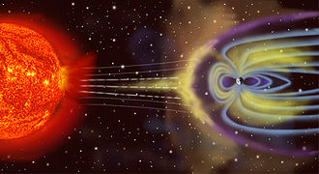
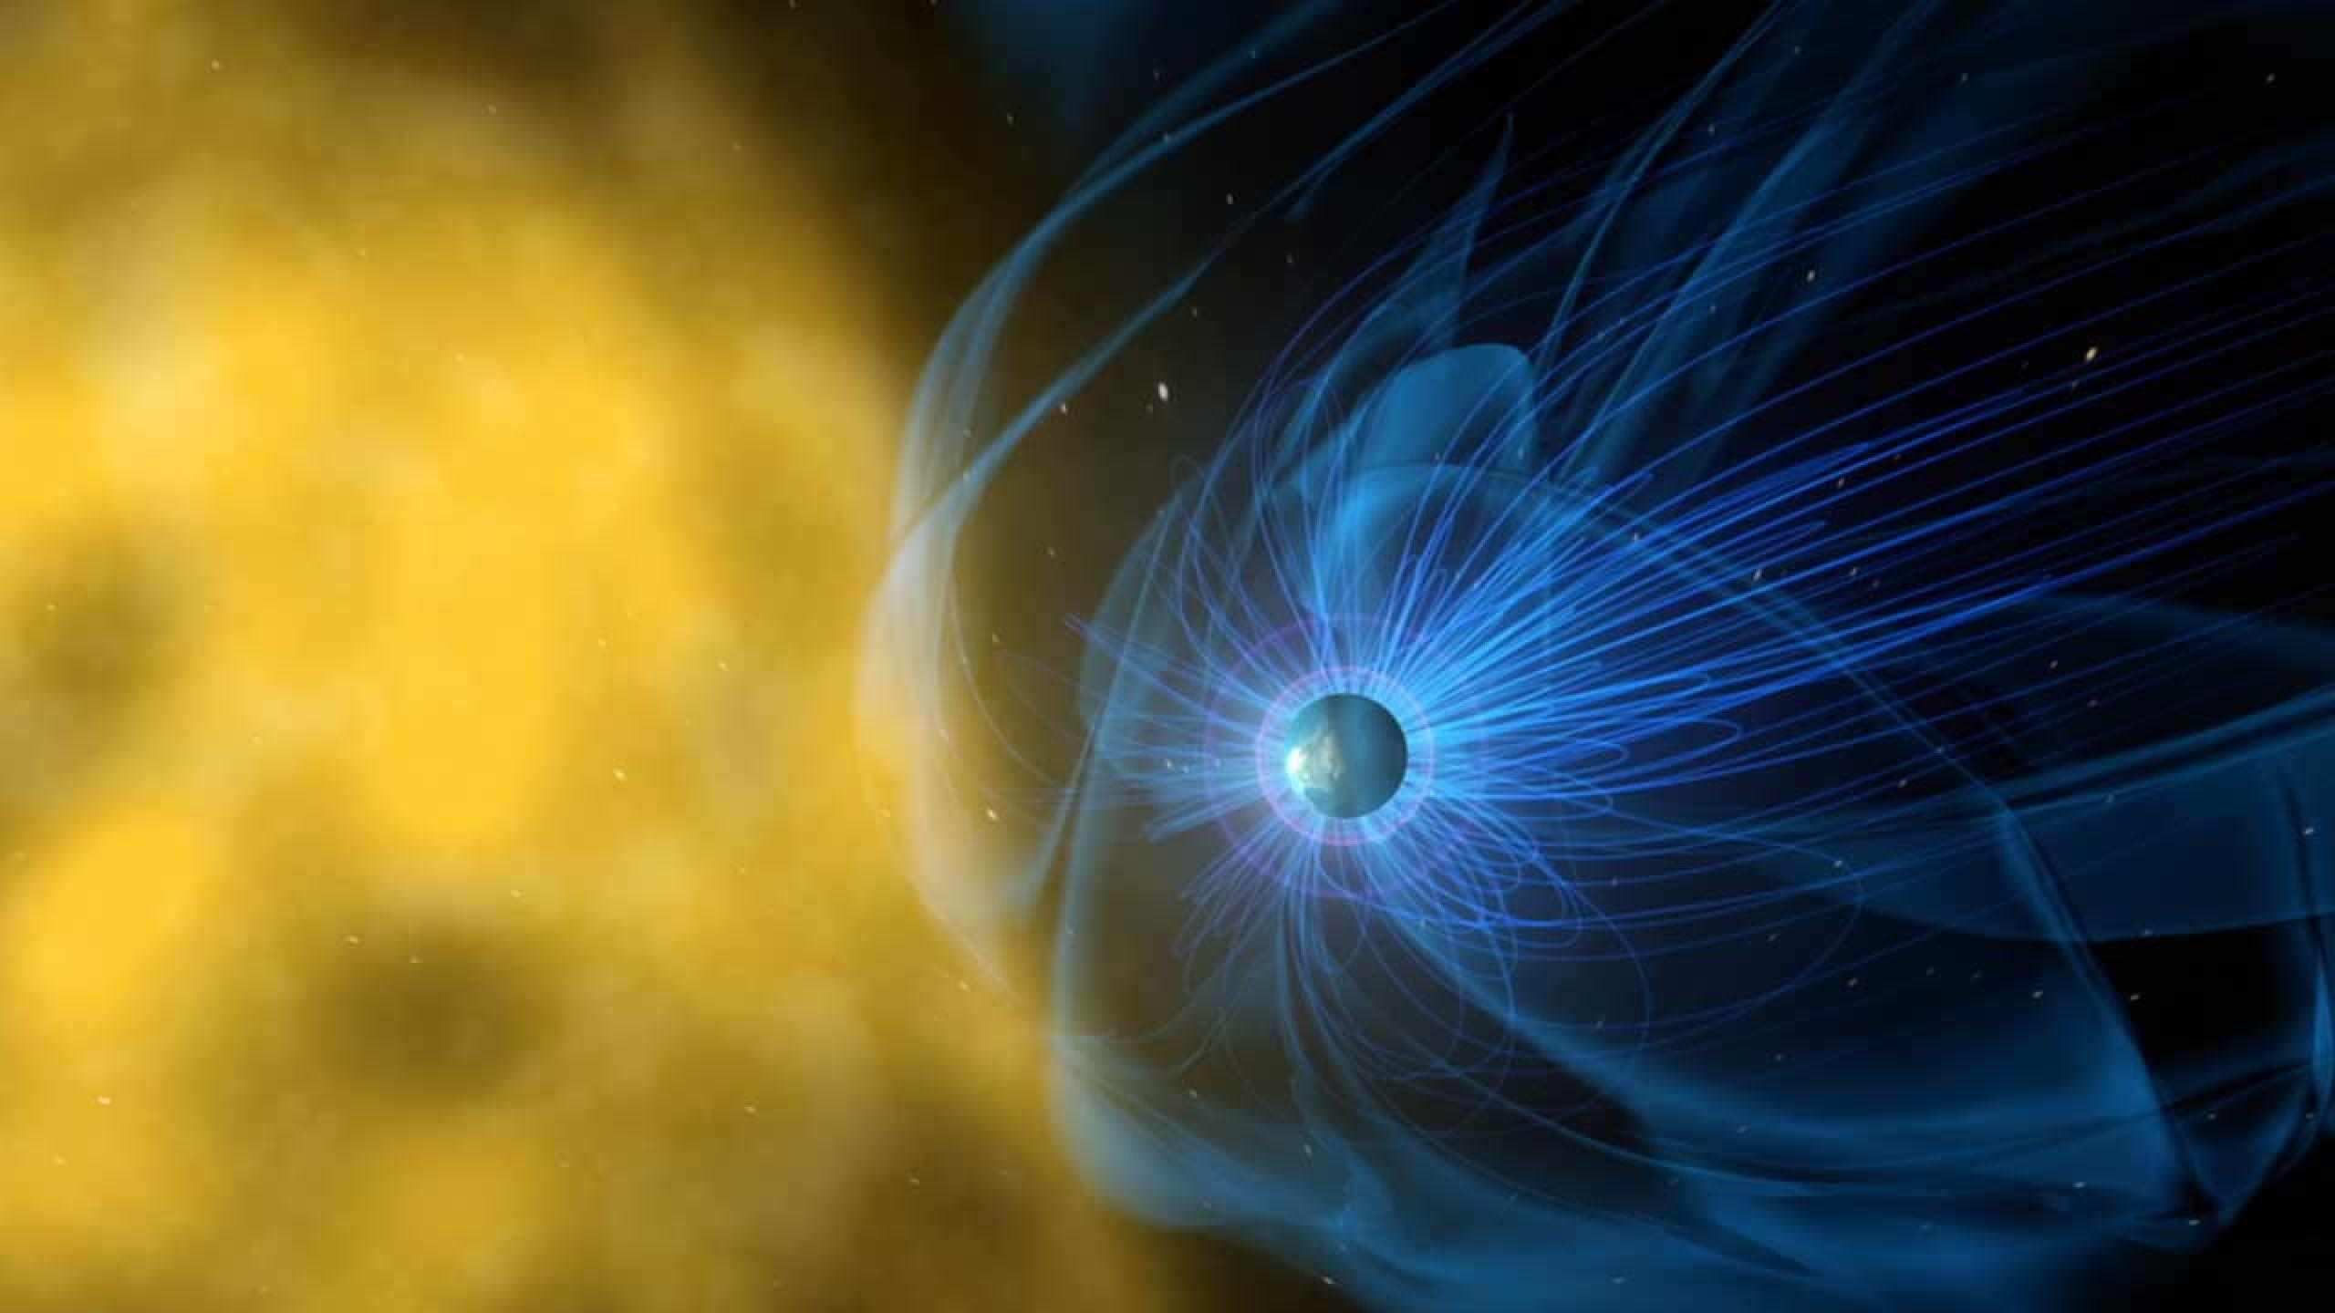
Cont…
Earth's magnetosphere is part of a dynamic, interconnected system that responds to solar, planetary, and interstellar conditions. It is generated by the convective motion of charged, molten iron, far below the surface in Earth's outer core. Constant bombardment by the solar wind compresses the sun-facing side of our magnetic field. On the dayside of Earth, the magnetic field is significantly compressed by the solar wind to a distance of approximately six to 10 times the radius of the Earth. The nightside - stretches out into an immense magnetotail, which fluctuates in length and can measure hundreds of Earth radii.
Note: Most of the information Collected about Magnetosphere are from- https://science.nasa.gov/heliophysics/focus-areas/magnetosphere-ionosphere
Image Source: Ref.-2
Image Source: Ref.-1

Slide 15
References:
https://science.nasa.gov/heliophysics/focus-areas/magnetosphere-ionosphere
https://en.wikipedia.org/wiki/Magnetosphere#:~:text=A%20magnetosphere%20is%20a%20region,field%20resembles%20a%20magnetic%20dipole.
https://spaceplace.nasa.gov/exosphere/en/
Barry, R. G., & Chorley, R. J. (2009). Atmosphere, weather and climate. Routledge.

Slide 16
THANK YOU !

