Slide 1
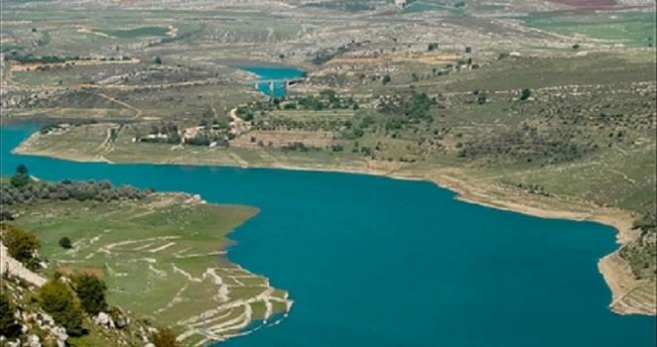
RIVER BASIN AS A HYDROLOGICAL UNIT
CLASS: 5TH SEM
PAPER: DSE
UNIT-I-3
DONE BY : SK SAFIKUL HAQUE, GEOGRAPHY, KHARAGPUR COLLEGE.

Slide 2
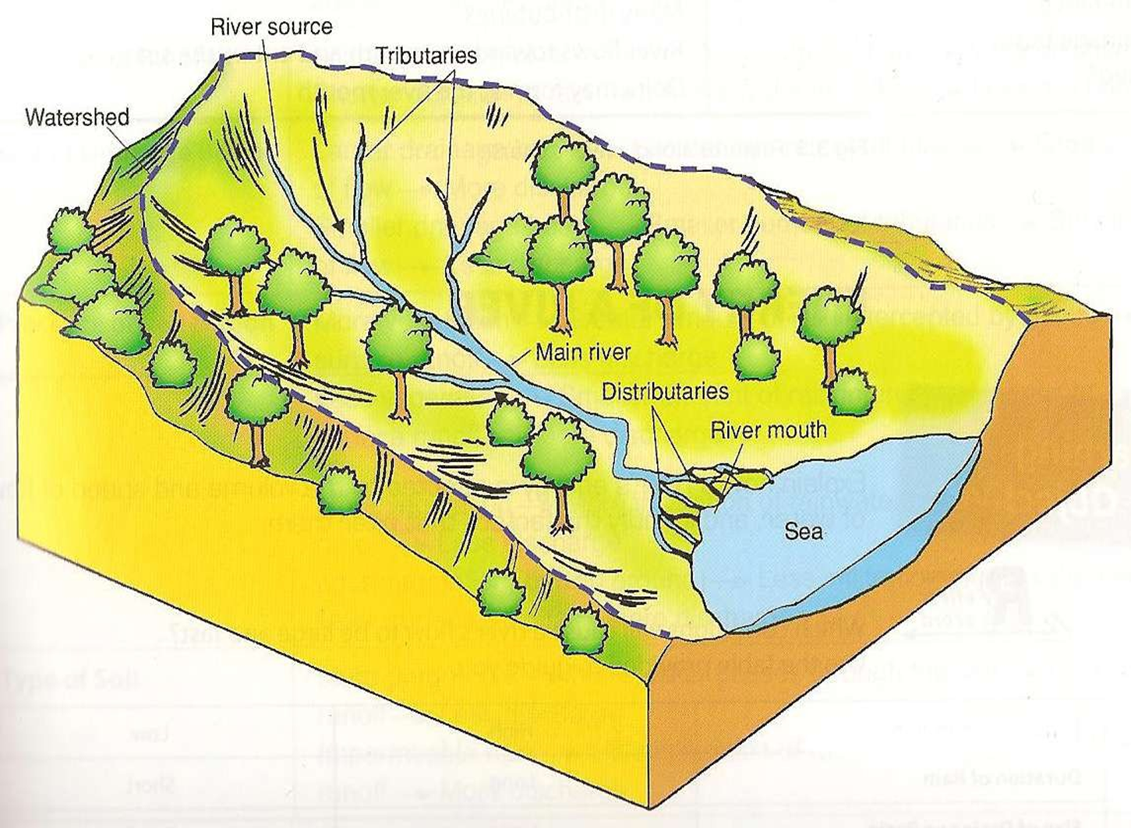
WHAT IS RIVER BASIN ?
An area of land drained by a river and its tributaries where any precipitation is collected or drained into it.
2. Its boundary is marked by a ridge of high land called watershed
3. Drainage basins have one main stream and many tributaries

Slide 3
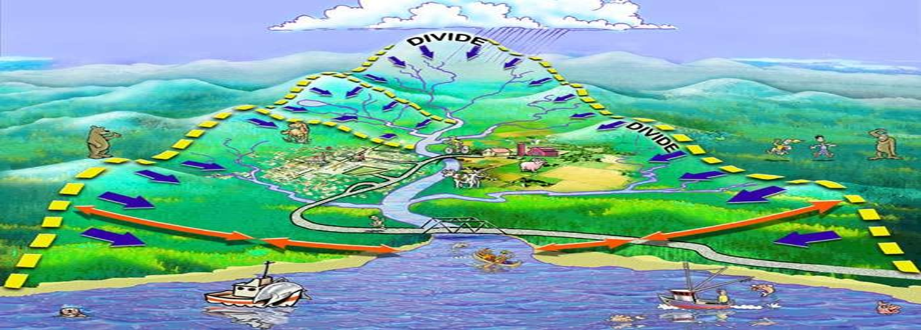
Watershed: A stretch of land that surrounds drainage basin (a.k.a. boundary)
Drainage Basin: A river system that collects rainwater and comprises of streams and river
Tributaries: Streams that flow in the river which is mainly found in the upper course.
Distributaries: Branch out from the river which is mainly found in the river delta.
River Source: Point where the river starts
River Mouth: Place where the river meets the sea / ocean (River ends)

Slide 4
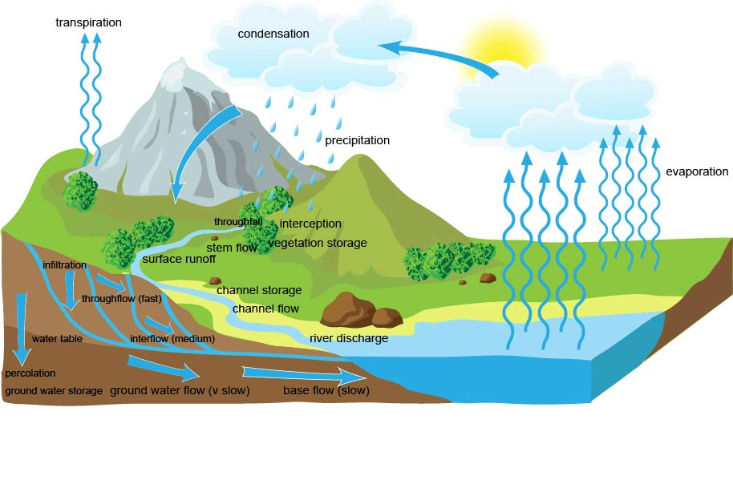
FORMULA FOR RIVER BASIN HYDROLOGICAL SYSTEM
P= q+e+Δ (IRML GS)
WHERE, P= Precipitation
q= Flow water
e= Evaporation
I= Interception Stage
R= Reserve Of Ground Water
M= Moisture Of Soil
L= Water In Layer Of Aeration
G=Ground Water Storage
S= Soil Water

Slide 5
Important terms..
 Interception : precipitation lands on vegetation.
 Infiltration : Water that reaches ground surface will soak into soil.
 Overland flow : water moving over the ground.
 Throughfall : precipitation passing through the plant canopy
 Percolation : Some water sinks deep into the earth (percolates) through openings in the soil.
 Stemflow : water that flow down tree trunks or plant stems.
 Groundwater : water transfer through permeable rocks from the soil above.
 Baseflow : water flows from groundwater stores to the stream
 Throughflow : water moving through the soil.
 Surface run-off : water that flows over the land surface.

Slide 6
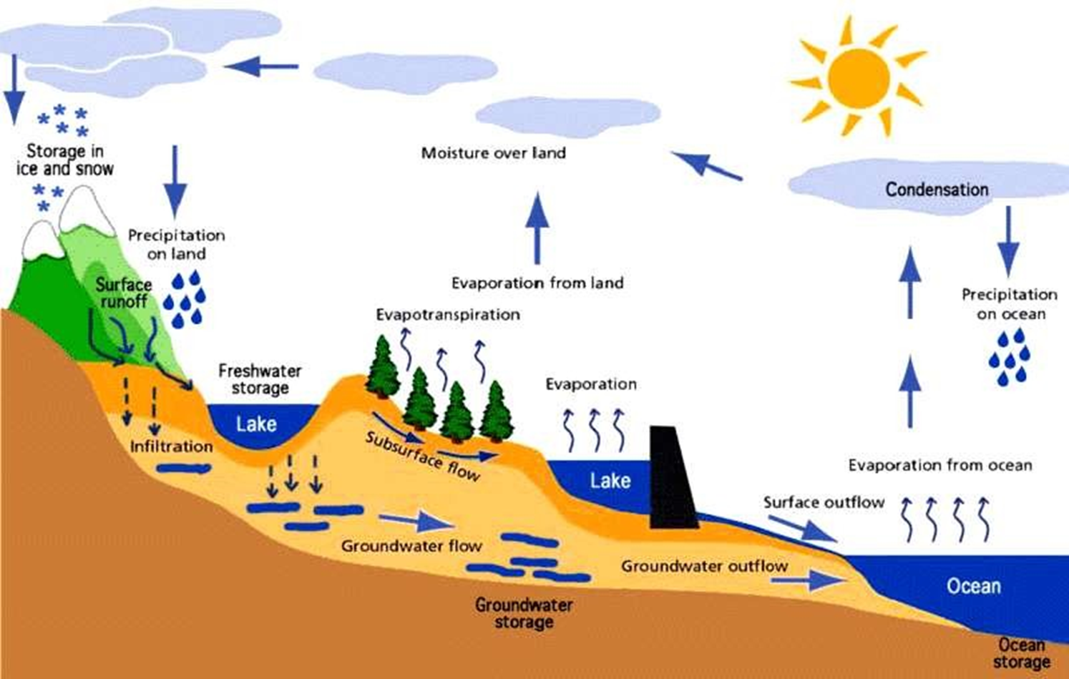
COMPONENTS
Length and Shape Of the Basin
Number Of Stream in the catchment basin
Nature Of base rock
Amount Of Precipitation
Amount Of Temperature
Location Of Vegetation

Slide 8
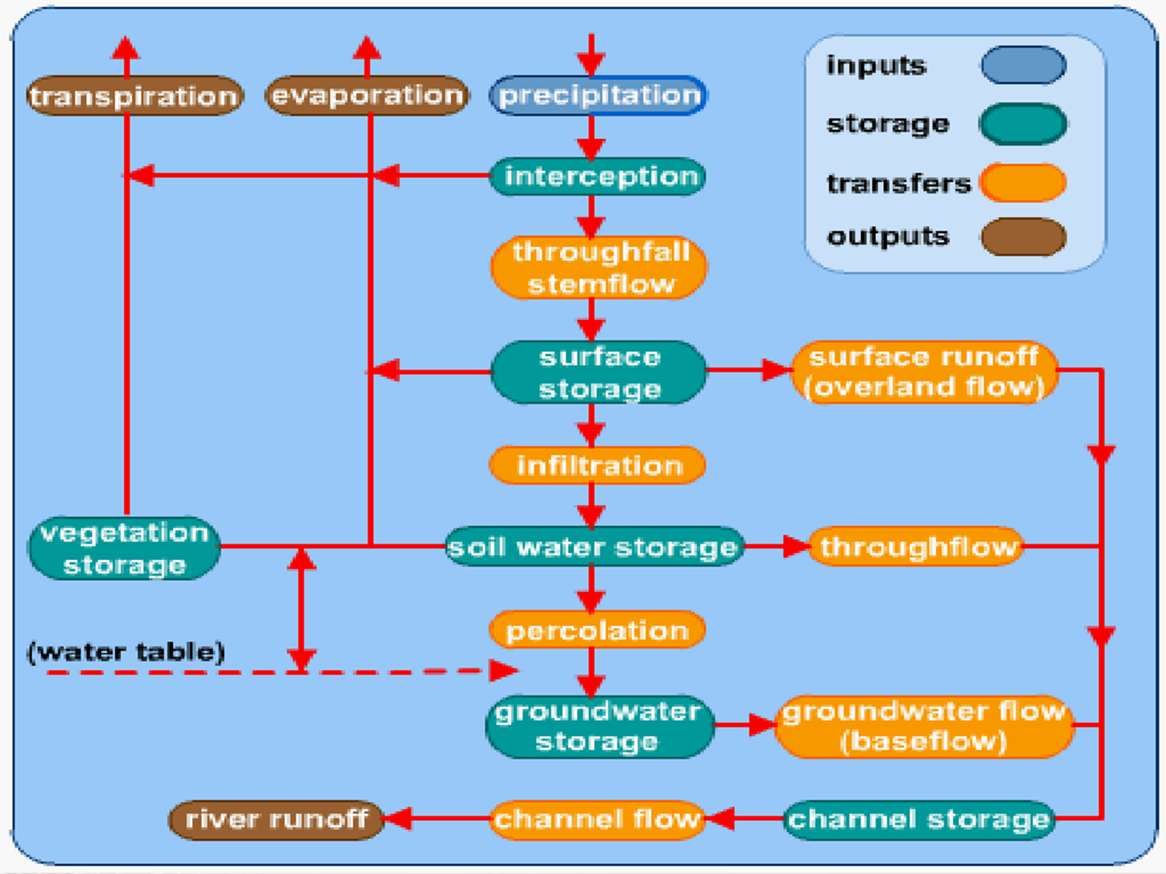

Slide 9
CITATIONS
https://www.slideshare.net/SitiMutiahAliUmar/the-drainage-basin-as-a-system-lesson-2
https://www.slideshare.net/geodebs/rivers-drainage-basin
https://www.slideshare.net/geodebs/rivers-hydro-cycle
https://en.wikipedia.org/wiki/Drainage_basin#:~:text=Drainage%20basins%20are%20the%20principal,they%20reshape%20the%20channel%20forms.
https://www.alevelgeography.com/drainage-basin-hydrological-system/
https://www.ldeo.columbia.edu/~martins/hydro/lectures/riverb.htm

Slide 10
Thank You
Any question

